Slide 1
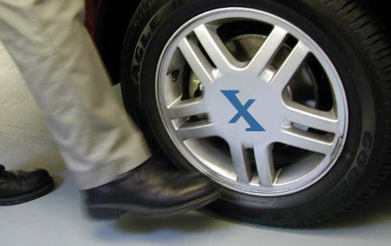
Nebraska Transit Invoice Website
“Kick the Tires”

Slide 2
Dana, Carol, Marilee, & Charles

Slide 3
Kick the Tires: Overview
Why
Q&A
How
Q&A
Create Log-ins
Chrome
User Name
Overall Impression, Suggestions!
Next Steps
Note: Everything in the system you type in until July 30 is for testing purposes only and will be DELETED effective July 31. Do not put anything in the database that is intended for actual use in your July 31 invoice submission.

Slide 4
WHY Move to an Online System?
Streamline Billing
Excel Version Issues
Rounding Issues
Reporting Limitations
Audit Requirements
Online Application Process in 2015
Develop “Intranet” portal with many tools for transit managers!

Slide 5
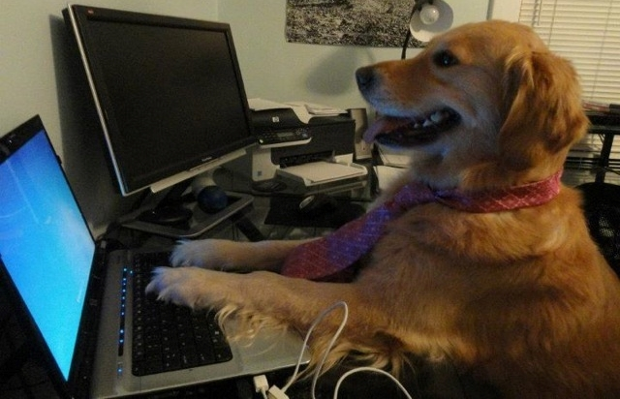
HOW: Invoice System Walkthrough
Step-by-Step

Slide 6
During the Walkthrough – INFORMAL
Feel free to:
Ask Questions
Ask “Why did you do it this way? or Why did this change?
Tell us if something does NOT make sense…
Tell us if you like a new feature or option for future consideration…
Tell us if you have an idea for reporting that would be helpful to you…
Tell us if something you feel is an improvement…
Above all, be:
Honest
Open
Sincere
THE GOAL OF THE SYSTEM IS TO BE USEFUL, HELPFUL, AND PRACTICAL

Slide 7
How to Use the New Invoice System
Welcome to the new Nebraska Transit Invoice System! These step-by-step instructions will show you how to set up a User Account and begin using the new system to create and submit invoices.
Step 1: Open or Download Google Chrome (Note: this step only has to be done once – you may skip it if you already have Chrome)
Step 2: The Invoice Website
Step 3: Create a New User Account
Step 4: Logging In
Step 5: Creating and Submitting Your First Invoice
Step 5a: Operating Revenue Worksheet
Step 5b: Local Matching Funds Worksheet
Step 5c: Operating Personnel Expenses Worksheet
Step 5d: Operating Expenses: Fuel or Oil Worksheet
Step 5e: Non-Operating Expenses (Personnel) Worksheet
Step 5f: Vehicle Maintenance Expenses (Other Non-Operating) Worksheet
Step 5g: Other Non-Operating and Capital Expenses Worksheet
Step 5h: Operating Statistics Worksheet
Step 6: Viewing Summaries and Submitting Invoices

Slide 8
Step 1

Slide 9
Step 1: Open or Download Google Chrome
NOTE: You may skip this step if you already have Google Chrome.
The invoice system is not compatible with older versions of Mozilla Firefox or Internet Explorer. The best and easiest way to use the invoice system is through the Google Chrome web browser.

Slide 10
Step 1: Open or Download Google Chrome
The Internet Explorer and Mozilla Firefox icons look like this:
The Google Chrome icon looks like this:
If you do not have Google Chrome on your computer, it is free and easy to install in a matter of minutes using the following instructions.
NOTE: the invoice system is compatible with Mozilla Firefox or Internet Explorer, but only if those programs are up-to-date with the latest version. For ease of use, we recommend installing and/or using Google Chrome.

Slide 11
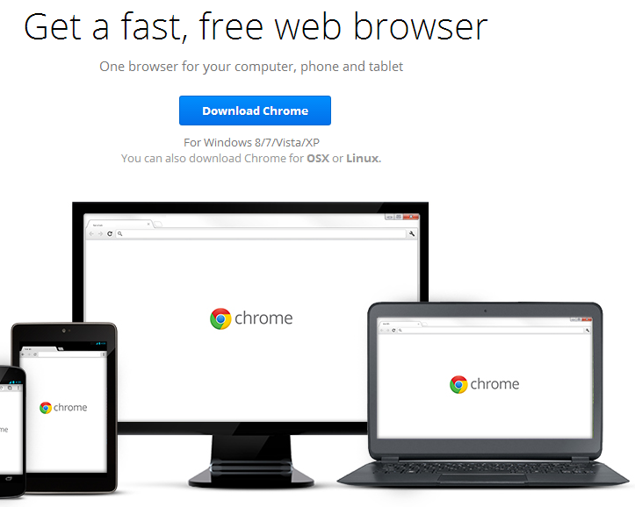
Step 1: Downloading Google Chrome
Open a web browser, such as Mozilla Firefox or Internet Explorer.
Click this link, or copy/paste it into the web search bar: https://www.google.com/intl/en_us/chrome/browser/
You will arrive at a screen that looks like this:
Click Download Chrome.

Slide 12
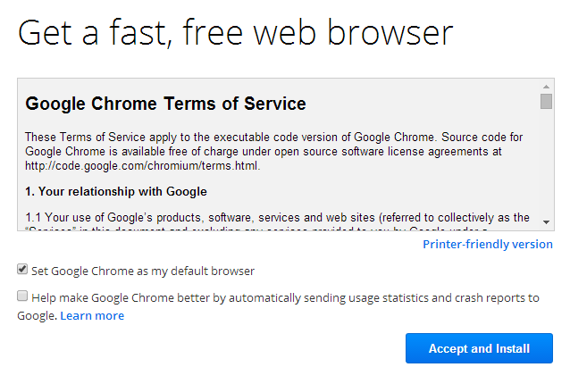
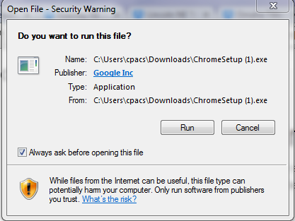
Step 1: Downloading Google Chrome
You will reach the terms and conditions page. You may or may not choose to set Chrome as your default browser by clicking the box marked Set Google Chrome as my Default Browser.
Click Accept and Install.
At the bottom of your screen, this icon will pop up. Click it:
Now this window will pop up: The program is completely secure, and will not harm your computer. Click Run.

Slide 13
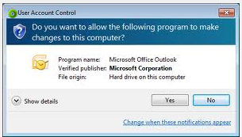
Step 1: Downloading Google Chrome
After clicking Run, the following box will pop up.
Click Yes. The program will begin downloading on your computer. In a few moments, the program will finish installing and the Google Chrome icon will appear on your desktop. You will now be able to use Google Chrome to access and use the invoice system.

Slide 14
Step 2

Slide 15
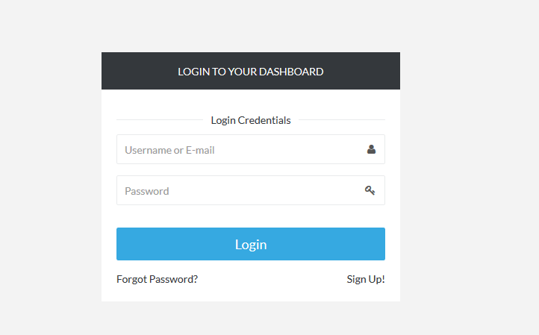
Step 2: The Invoice Website
Open Google Chrome and visit the following link to access the new invoice system:
http://nebraskatransit.com/invoice
You will arrive at the login screen for the new invoice system. From this screen, you can create a new account or access an existing account. First-time users must create a new account by following the directions in step 3.

Slide 16
Step 3

Slide 17
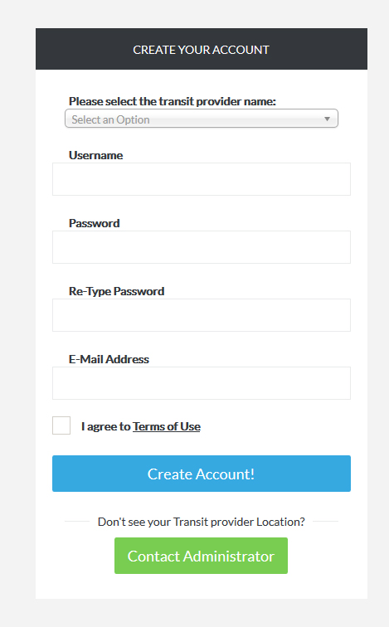
Step 3: Create a New User Account
Create a new user account by following these steps:
From the Login to your Dashboard screen, click Sign Up.
You will arrive at this screen:

Slide 18
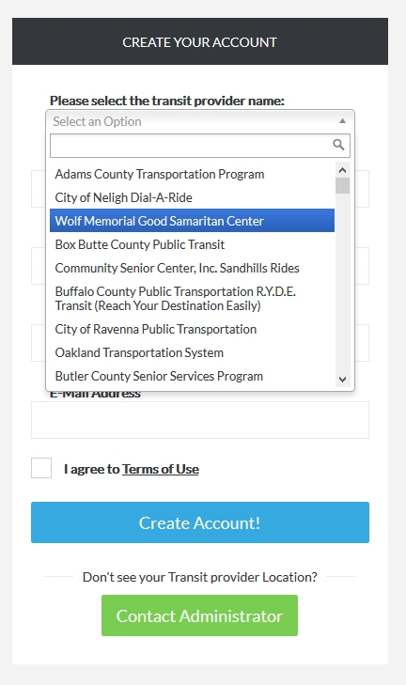
Step 3: Create a New User Account
Select your Transit Provider Name from the dropdown menu.
If your Transit Provider Name is not listed in the dropdown menu, click Contact Administrator, which will open a pre-addressed email to the Nebraska Transit Support Team; please specify in this email that you were unable to locate your transit provider name, and someone from our team will email you back as soon as possible.

Slide 19
Step 3: Create a New User Account
After selecting your Transit Provider Name from the dropdown menu, create a Username in the space provided. Your Username should be 5-10 characters in length.
Next, create a Password in the space provided. Passwords should be 5-10 characters in length.
Retype your Password in the space provided.

Slide 20
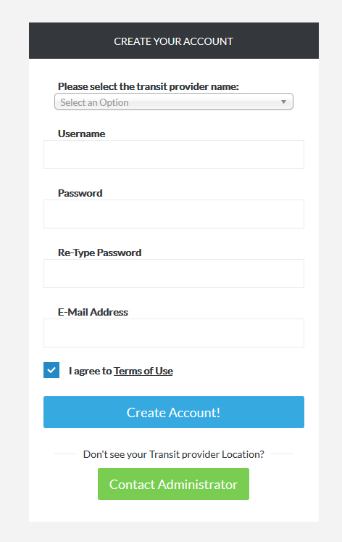
Step 3: Create a New User Account
Next, in the space provided, type in the email address that you wish to be associated with this system.
Click on the underlined Terms of Use, which will bring up the Terms of Use page. After reading the Terms of Use, click the box next to I agree to the terms of use to proceed.

Slide 21
Step 3: Create a New User Account
Click Create Account! From here, you will be redirected to the Login Screen. You have now created an account, and are ready to login.
To login, follow the instructions in Step 4.

Slide 22
Step 4

Slide 23
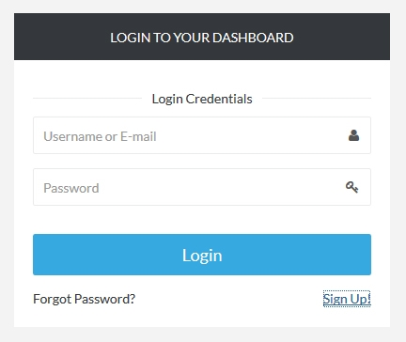
Step 4: Logging In
From the Login Screen, enter your new username and password to login. If you forgot your password, click Forgot Password? and follow the instructions to retrieve your password.
If you forgot your username, you can still login by using the email address you entered in Step 2.
After clicking Login, you will be directed to the Dashboard Page (see following slide). The Dashboard Page is like a home base.

Slide 24
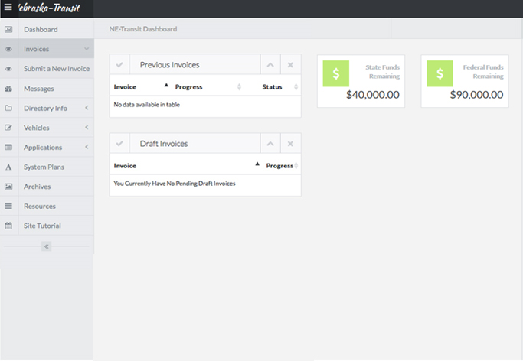
Step 4: Logging In
The dashboard page looks like this:
From the dashboard page, you can begin a new invoice by following the instructions in step 5.

Slide 25
Step 4: Logging In
From the Dashboard Page, you can:
Create a new invoice.
View and change your previous invoices or draft invoices, or see the see the status of any invoices that are currently in-progress.
View the amount of your remaining State and Federal funds.

Slide 26
Step 5

Slide 27
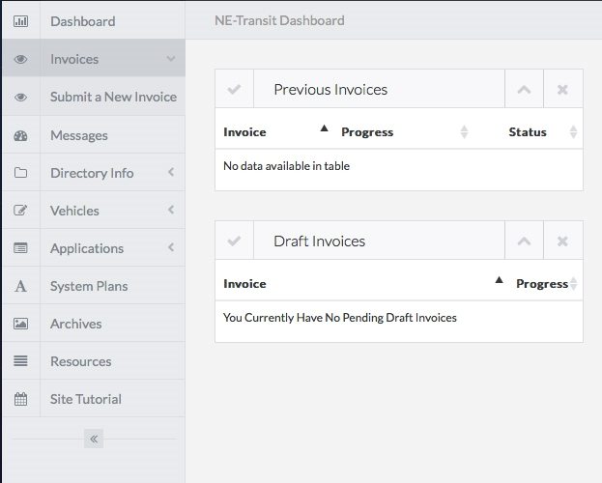
Step 5: Creating and Submitting Your First Invoice
To begin a new invoice, from the Dashboard Page, click Invoices in the left-hand navigation bar. Next, click Submit a new invoice.

Slide 28
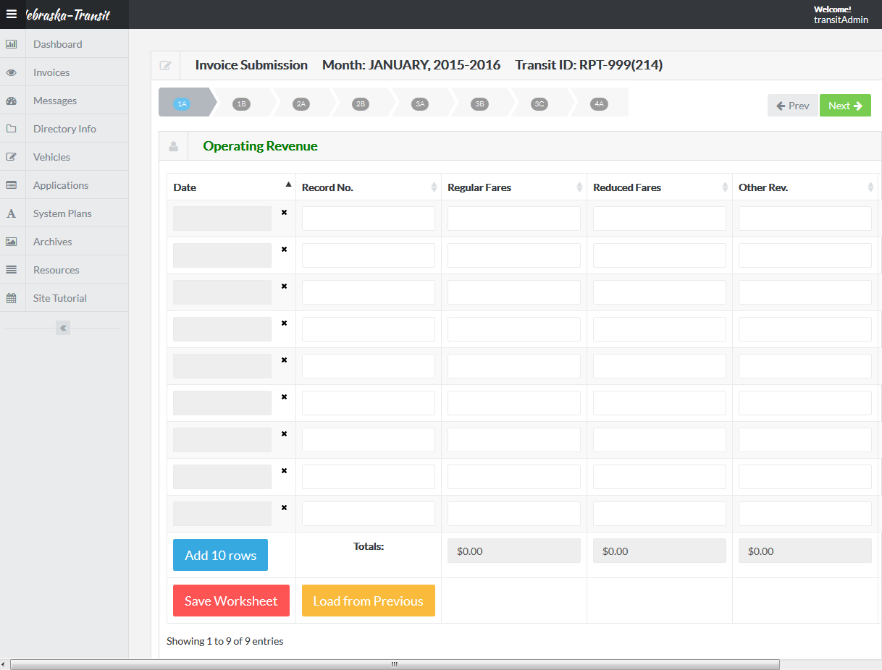
Step 5: Creating and Submitting Your First Invoice
You will arrive at the first invoice data entry worksheet, Operating Revenue. The first worksheet looks like this:

Slide 29
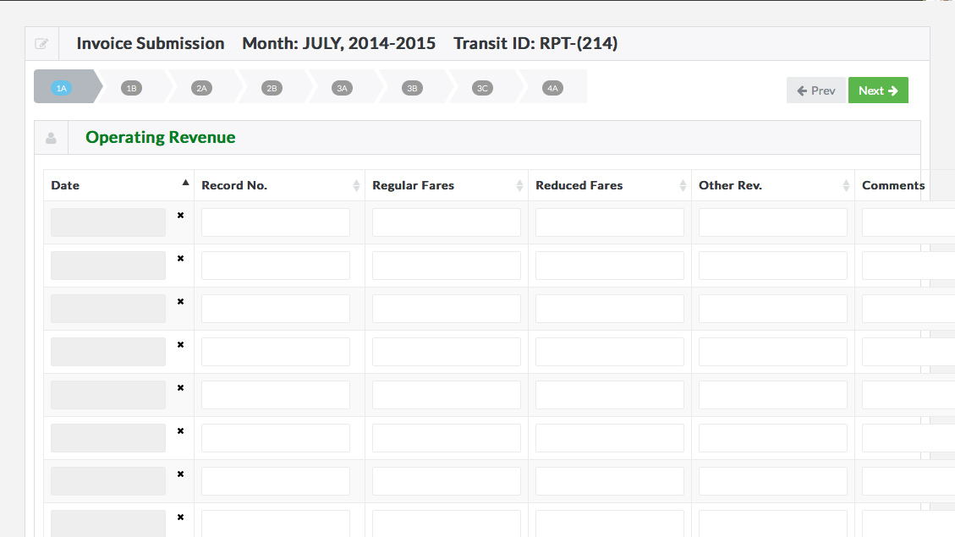
Step 5: Creating and Submitting Your First Invoice
There are eight worksheets in total. You can navigate forward and backwards through the worksheets by clicking on the Prev and Next arrows on the top right.
NOTE: You must save each worksheet as you go. You will not be allowed to view a final summary (discussed in a later slide) until each individual worksheet has been saved. The save button can be found at the bottom of each worksheet.

Slide 30
Step 5a:
Operating Revenue Worksheet

Slide 31
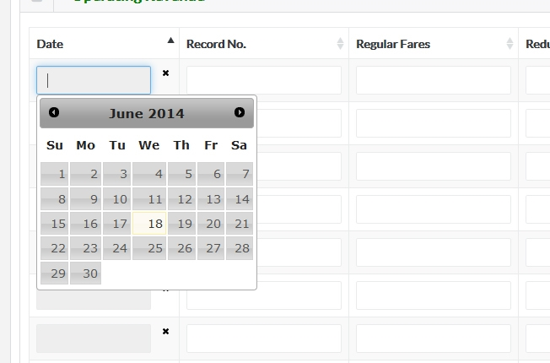
Step 5a: Operating Revenue Worksheet
In the first worksheet, Operating Revenue, you will see a series of columns with labels at the top, i.e., Date, Record No., Regular Fares, etc.
To fill out the worksheet, click on the first empty cell under the Date column. A pop-up calendar will appear. Click on the correct date for this entry (To choose a different month, use the arrows at the top of the calendar [shown at bottom right, highlighted by red boxes]).

Slide 32
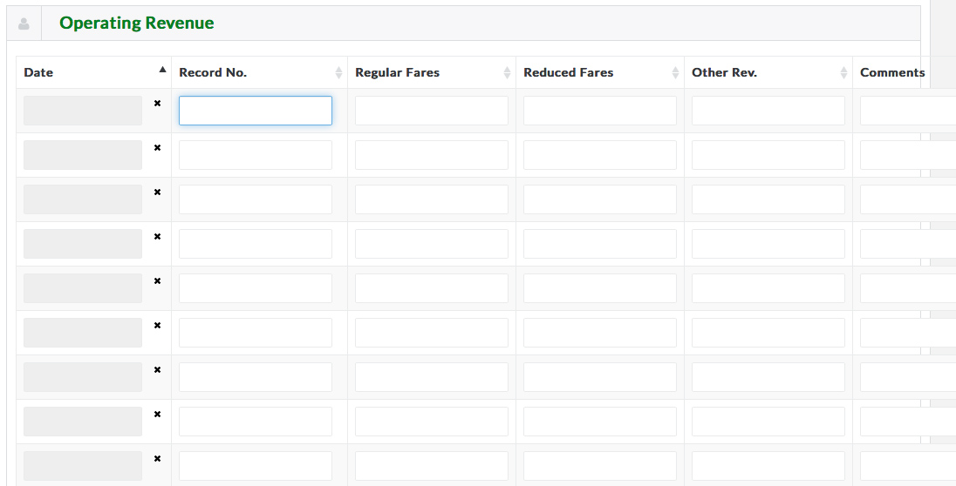
Step 5a: Operating Revenue Worksheet
Next, click on the first empty cell under the Record No. column. Enter the correct record number. The Record number is yours to choose following your current practices.

Slide 33
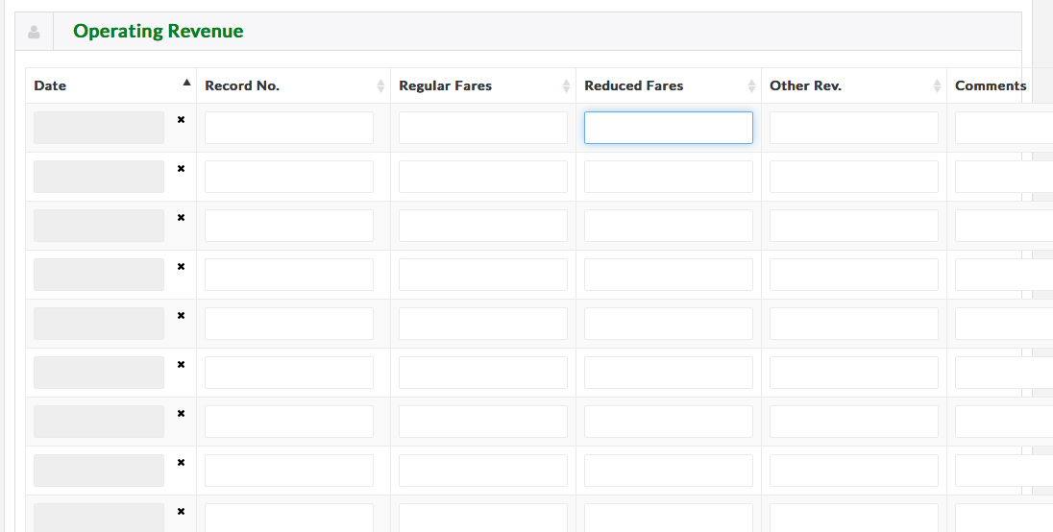
Step 5a: Operating Revenue Worksheet
Then, click on the first empty cell under Reduced Fares. Enter the correct number. Do the same for Other Rev.
For non-entries, simply leave the cell blank.
Continue working left to right until you have made an entry into each column.
Note: the last column provides a space to leave comments and is required if other revenue is entered.

Slide 34
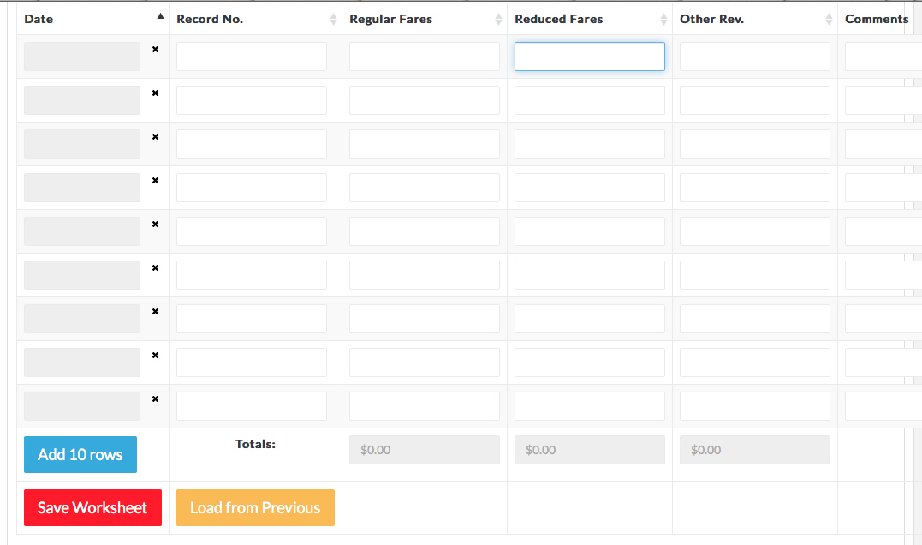
Step 5a: Operating Revenue Worksheet
To begin a new row, click on the next empty Date cell and work left to right, as previously.
If you run out of rows, click Add 10 Rows. This button can be found at the bottom of the worksheet.

Slide 35
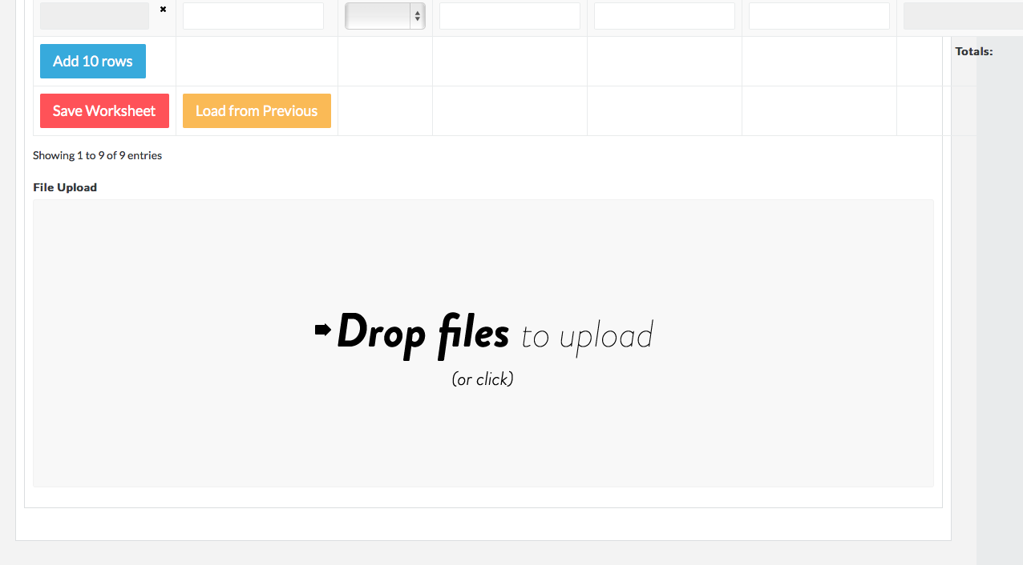
Step 5a: Operating Revenue Worksheet
You can also upload supporting documents any time by dragging and dropping files into the Drop Files to Upload box located at the bottom of the page.
Please wait for each of your files to finish uploading before moving on. When each file has been loaded, a checkmark will appear.

Slide 36
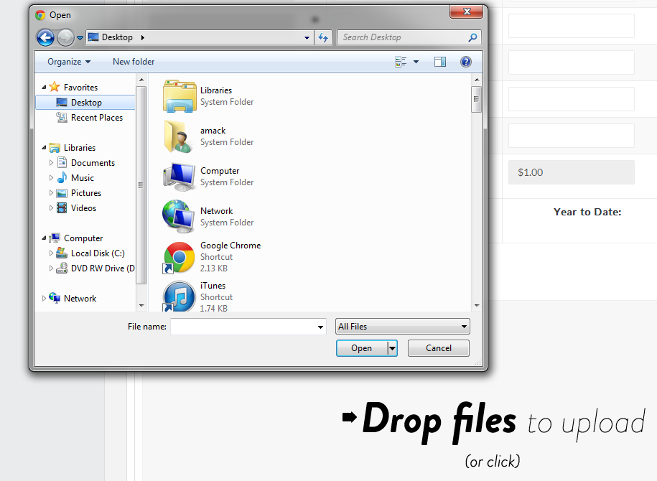
Step 5a: Operating Revenue Worksheet
If you do not wish to drag and drop files, click on the box to browse for the file you want to upload. The following box will pop up. Browse until you find the file you wish to upload.

Slide 37
Step 5a: Operating Revenue Worksheet
When you have finished entering data into the “Operating Revenue” worksheet, click Save Worksheet. It is both a requirement and a best practice for you to save your work as you go. Each worksheet has a Save Worksheet button at the bottom of each table.

Slide 38
Step 5a: Operating Revenue Worksheet
To begin on the next worksheet, click Next.

Slide 39
Step 5b:
Local Matching Funds Worksheet

Slide 40
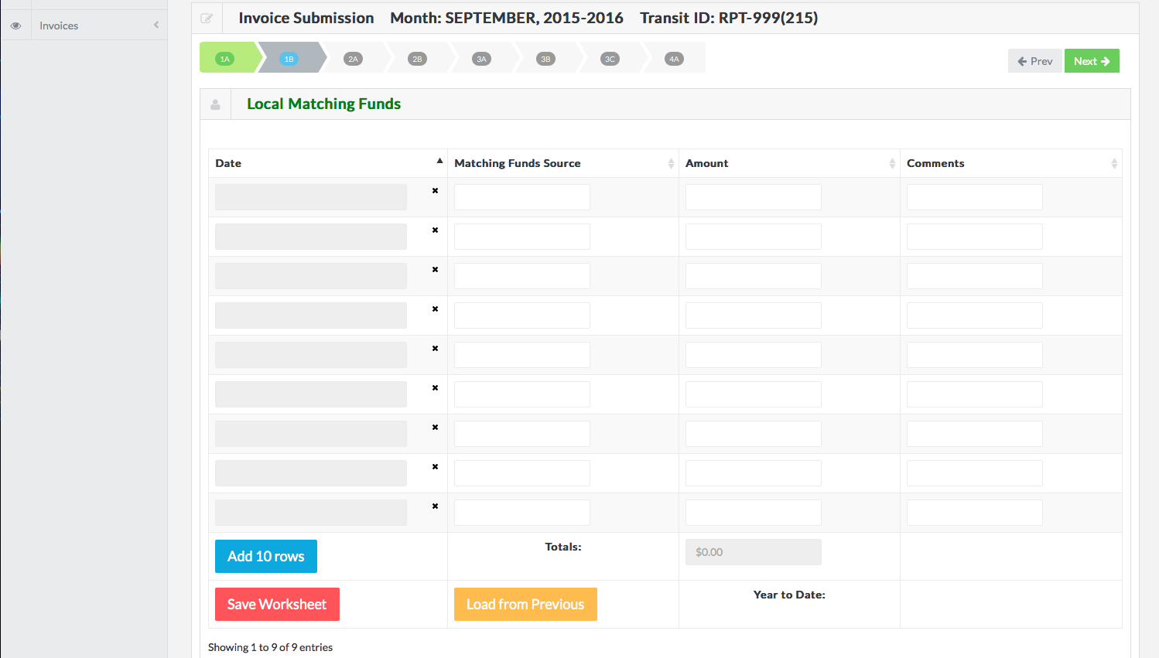
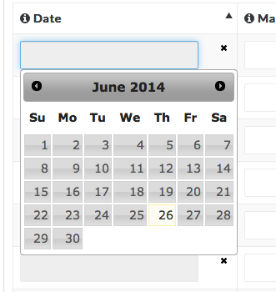
Step 5b: Local Matching Funds Worksheet
To begin entering data, click the first empty cell in the Date column to select a date. A dropdown menu will appear, just like the one in the Operating Revenue worksheet.

Slide 41
Step 5b: Local Matching Funds Worksheet
Next, enter a Matching Funds Source in the 2nd column, Matching Funds Source.

Slide 42
Step 5b: Local Matching Funds Worksheet
Enter the correct amount in the 3rd column, Amount.

Slide 43
Step 5b: Local Matching Funds Worksheet
Remember, you can leave comments in the Comments column.

Slide 44
Step 5b: Local Matching Funds Worksheet
Finally, drag-and-drop any supporting documents into the Drop Files to Upload box, or, simply click on the box to select the correct file to upload. Wait until the first file has finished uploading before adding additional files. Files have finished uploading when you see the green check mark. To remove a file once you have uploaded it, simply click Remove.

Slide 45
Step 5b: Local Matching Funds Worksheet
Begin your next invoicing entry in the 2nd row. Continue working until you have entered all of your data. If you need more rows, click Add 10 Rows.

Slide 46
Step 5b: Local Matching Funds Worksheet
Remember to save your work before moving onto the next worksheet!
To move to the next invoicing worksheet, click Next.

Slide 47
Step 5c
Operating Personnel Expenses Worksheet

Slide 48
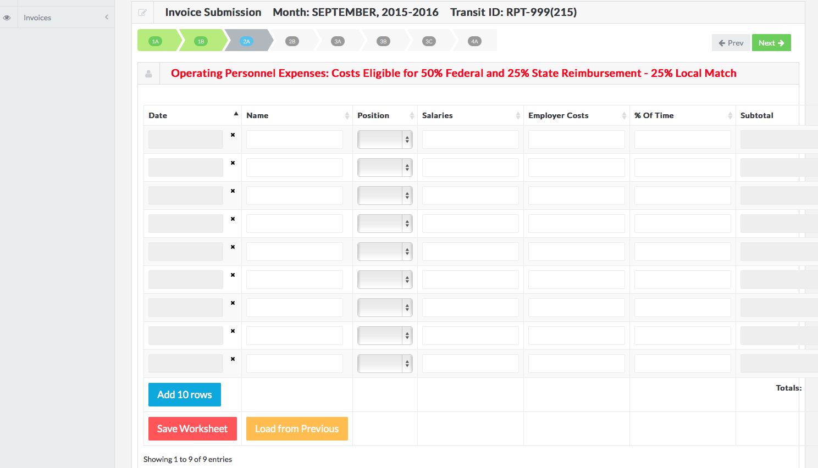
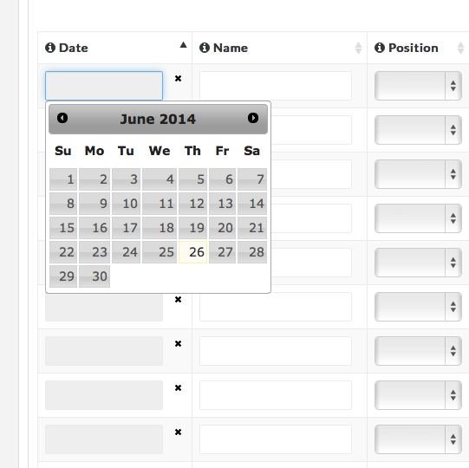
Step 5c: Operating Personnel Expenses Worksheet
To begin entering data, click the first empty cell to enter a date in the Date column.

Slide 49
Step 5c: Operating Personnel Expenses Worksheet
Next, enter the correct personnel name in the Name column.

Slide 50
Step 5c: Operating Personnel Expenses Worksheet
Then, select the correct personnel position from the dropdown menu in the Position column.

Slide 51
Step 5c: Operating Personnel Expenses Worksheet
Next, enter the correct salary into the Salaries column.

Slide 52
Step 5c: Operating Personnel Expenses Worksheet
Enter Employer Costs in the Employer Costs column.

Slide 53
Step 5c: Operating Personnel Expenses Worksheet
Next, enter the correct percent of time into the % of Time column.
Percent of time is the percent of a normal workweek that a personnel member usually spends working in a transit-related capacity. For example, if a personnel member spends 75% of his or her time working in a transit-related capacity, enter 75% into this column.

Slide 54
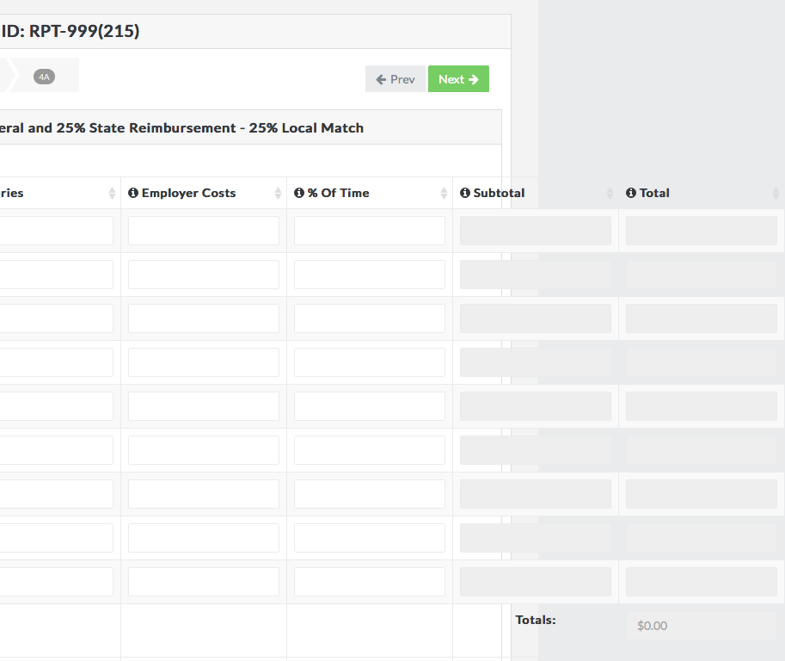
Step 5c: Operating Personnel Expenses Worksheet
Next, enter the correct subtotal into the Subtotal column.

Slide 55
Step 5c: Operating Personnel Expenses Worksheet
Enter the correct total into the Total column.

Slide 56
Step 5c: Operating Personnel Expenses Worksheet
Finally, drag-and-drop any supporting documents into the Drop Files to Upload box, or, simply click on the box to select the correct file to upload. Wait until the first file has finished uploading before adding additional files. Files have finished uploading when you see the green check mark. To remove a file once you have uploaded it, simply click Remove.

Slide 57
Step 5c: Operating Personnel Expenses Worksheet
Begin your next invoicing entry in the 2nd row. Continue working until you have entered all of your data. If you need more rows, click Add 10 Rows.

Slide 58
Step 5c: Operating Personnel Expenses Worksheet
Remember to save your work before moving onto the next worksheet!
To begin on the next worksheet, click Next.

Slide 59
Step 5d
Operating Expenses (Fuel or Oil) Worksheet

Slide 60
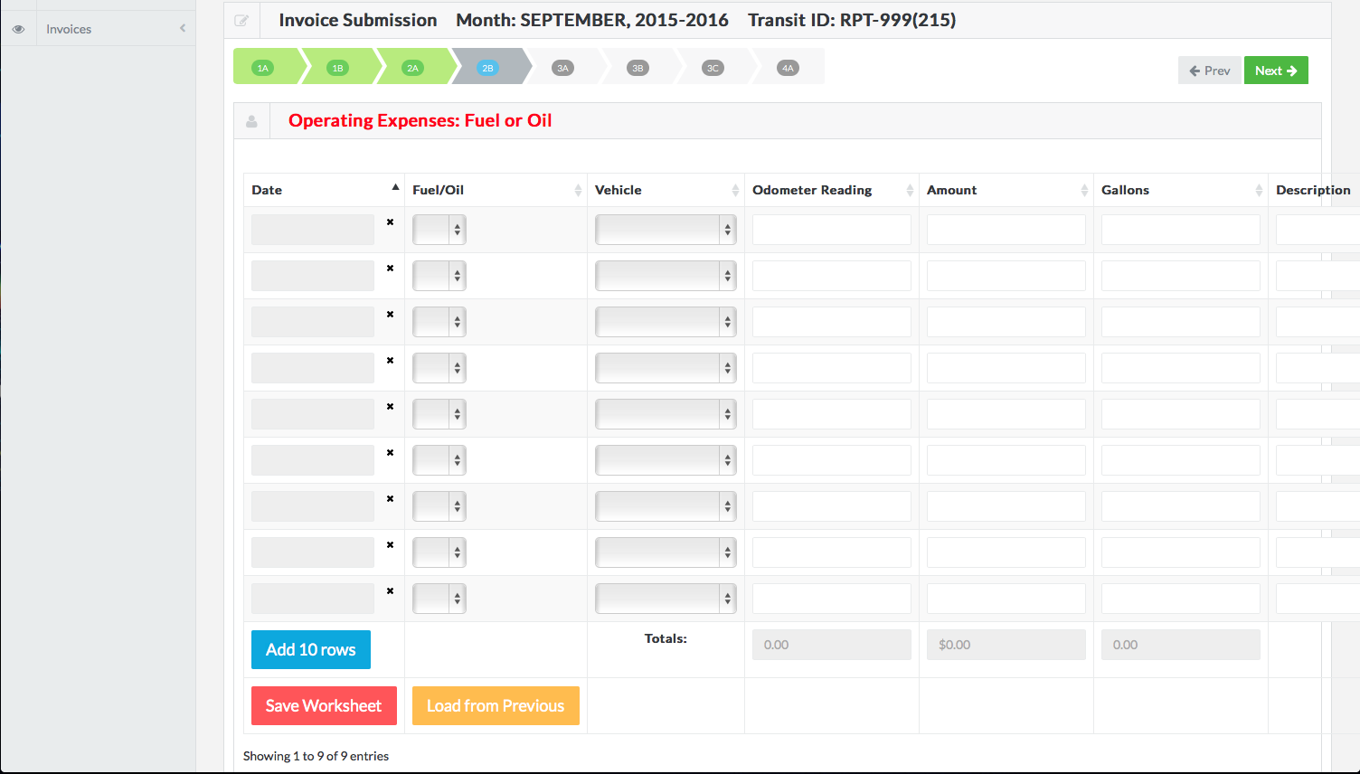
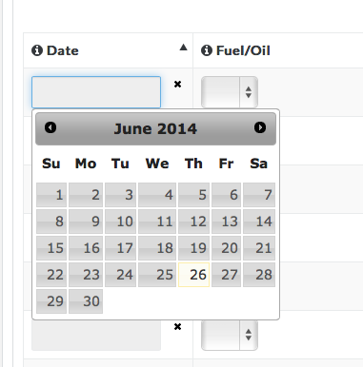
Step 5d: Operating Expenses: Fuel or Oil Worksheet
To begin entering data, click the first empty cell to enter a date in the Date column.

Slide 61
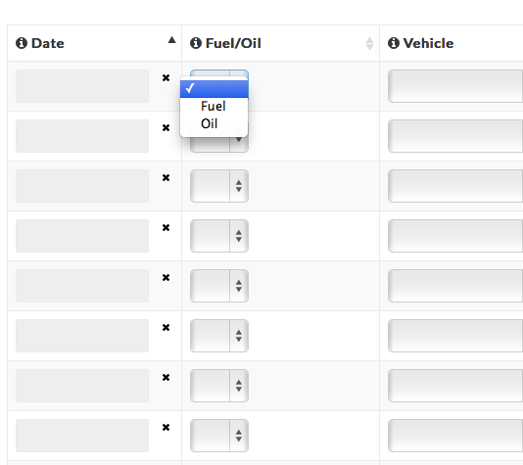
Step 5d: Operating Expenses: Fuel or Oil Worksheet
Next, select fuel or oil from the dropdown menu in the Fuel/Oil column.

Slide 62
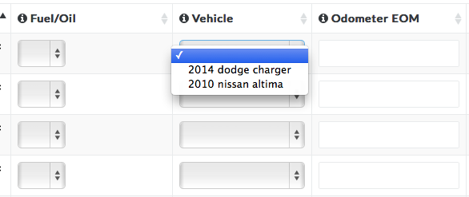
Step 5d: Operating Expenses: Fuel or Oil Worksheet
Select the correct vehicle type from the dropdown menu in the Vehicle column.
If your vehicle is not listed in the dropdown menu, please email Kari Ruse, NDOR Transit Liaison Manager, at kari.ruse@Nebraska.gov.

Slide 63
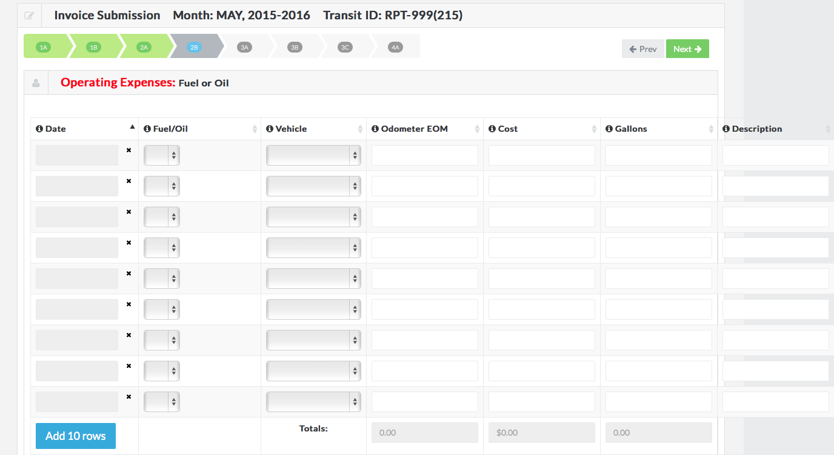
Step 5d: Operating Expenses: Fuel or Oil Worksheet
Next, enter the correct odometer reading into the Odometer EOM column.

Slide 64
Step 5d: Operating Expenses: Fuel or Oil Worksheet
Enter the correct cost into the Cost column.

Slide 65
Step 5d: Operating Expenses: Fuel or Oil Worksheet
Enter the number of gallons into the Gallons column.

Slide 66
Step 5d: Operating Expenses: Fuel or Oil Worksheet
Next, enter a description into the Description column.

Slide 67
Step 5d: Operating Expenses: Fuel or Oil Worksheet
Finally, drag-and-drop any supporting documents into the Drop Files to Upload box, or, simply click on the box to select the correct file to upload. Wait until the first file has finished uploading before adding additional files. Files have finished uploading when you see the green check mark. To remove a file once you have uploaded it, simply click Remove.

Slide 68
Step 5d: Operating Expenses: Fuel or Oil Worksheet
Begin your next entry in the 2nd row. Continue working until you have entered all of your data. If you need more rows, click Add 10 Rows.

Slide 69
Step 5d: Operating Expenses: Fuel or Oil Worksheet
Remember to save your work before moving onto the next worksheet!
To begin on the next invoicing worksheet, click Next.

Slide 70
Step 5e
Non-Operating Expenses (Personnel) Worksheet

Slide 71
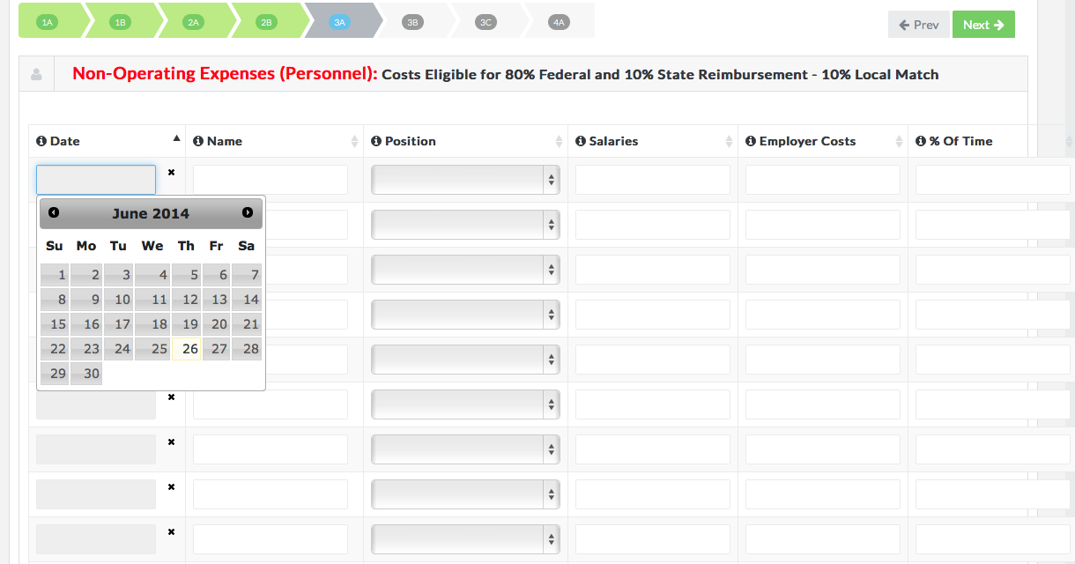
Step 5e: Non-Operating Expenses (Personnel) Worksheet
To begin entering data, click the first empty cell to enter a date in the Date column.

Slide 72
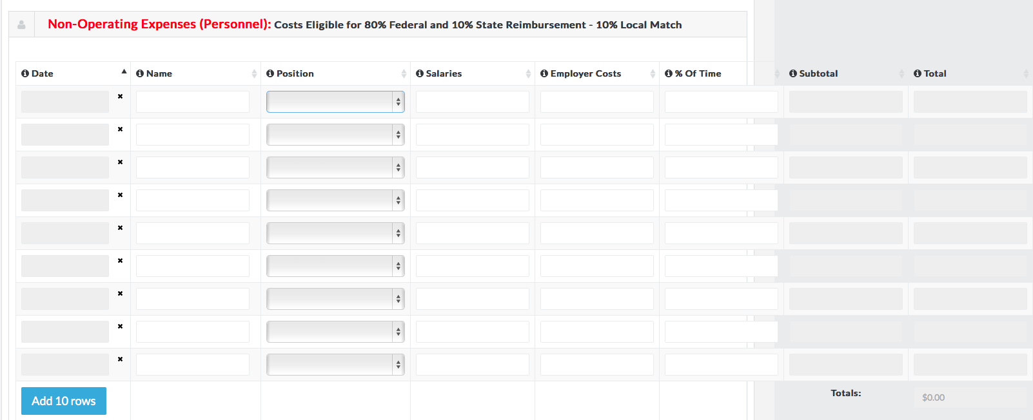
Step 5e: Non-Operating Expenses (Personnel) Worksheet
Next, enter the first personnel name in the Name column.

Slide 73
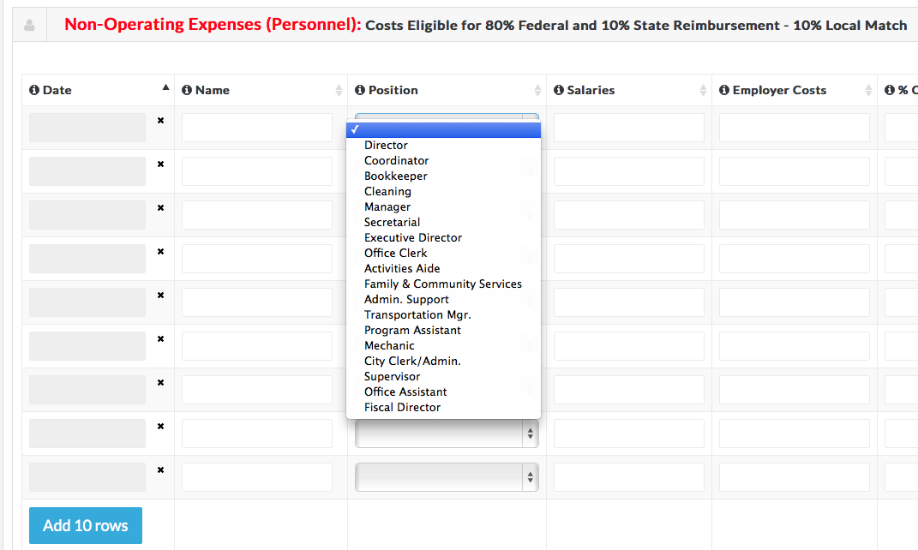
Step 5e: Non-Operating Expenses (Personnel) Worksheet
Select the correct position from the dropdown arrow in the Position column.

Slide 74
Step 5e: Non-Operating Expenses (Personnel) Worksheet
Enter the correct salary into the Salaries column.
v

Slide 75
Step 5e: Non-Operating Expenses (Personnel) Worksheet
Enter employer costs into the Employer Costs column.
v

Slide 76
Step 5e: Non-Operating Expenses (Personnel) Worksheet
Next, enter the correct percent of time into the % of Time column.
Percent of time is the percent of a normal workweek that a personnel member usually spends working in a transit-related capacity. For example, if a personnel member spends 75% of his or her time working in a transit-related capacity, enter 75% into this column.
v

Slide 77
Step 5e: Non-Operating Expenses (Personnel) Worksheet
Next, enter the correct subtotal into the Subtotal column.

Slide 78
Step 5e: Non-Operating Expenses (Personnel) Worksheet
Enter the correct total into the Total column.

Slide 79
Step 5e: Non-Operating Expenses (Personnel) Worksheet
Finally, drag-and-drop any supporting documents into the Drop Files to Upload box, or, simply click on the box to select the correct file to upload. Wait until the first file has finished uploading before adding additional files. Files have finished uploading when you see the green check mark. To remove a file once you have uploaded it, simply click Remove.

Slide 80
Step 5e: Non-Operating Expenses (Personnel) Worksheet
Begin your next entry in the 2nd row. Continue working until you have entered all of your data. If you need more rows, click Add 10 Rows.

Slide 81
Step 5e: Non-Operating Expenses (Personnel) Worksheet
Remember to save your work before moving onto the next worksheet!

Slide 82
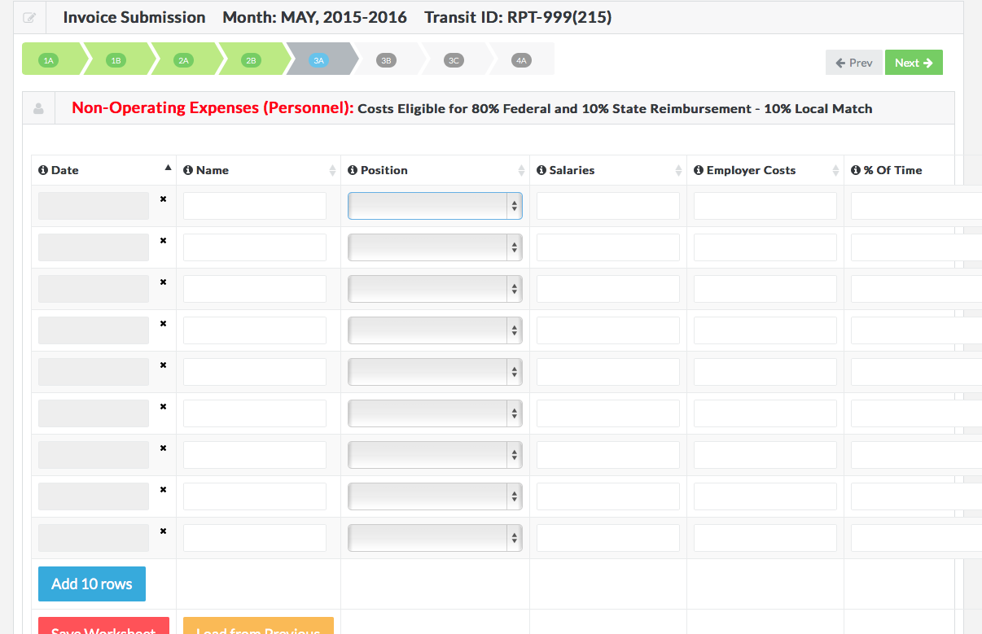
Step 5e: Non-Operating Expenses (Personnel) Worksheet
To begin on the next invoicing worksheet, click Next.

Slide 83
Step 5f
Vehicle Maintenance Expenses (Other Non-Operating) Worksheet

Slide 84
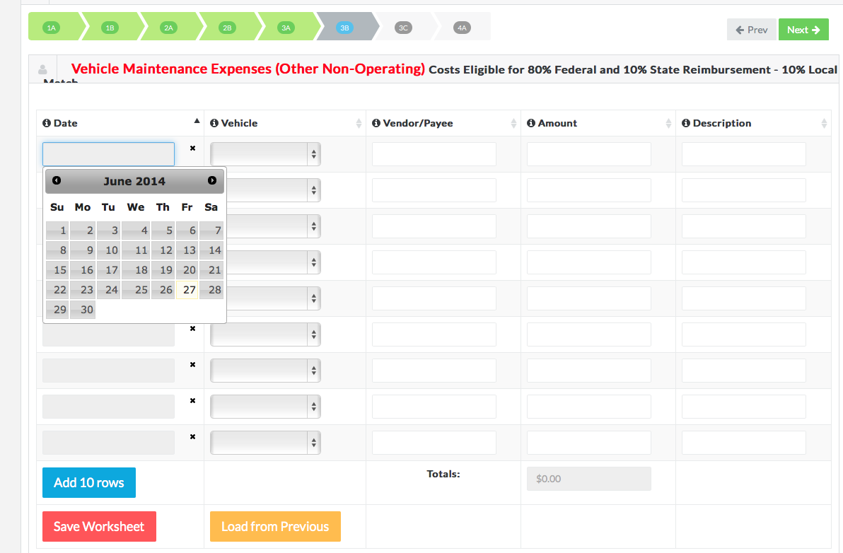
Step 5f: Vehicle Maintenance Expenses (Other Non-Operating) Worksheet
To begin entering data, click the first empty cell to select a date in the Date column.

Slide 85
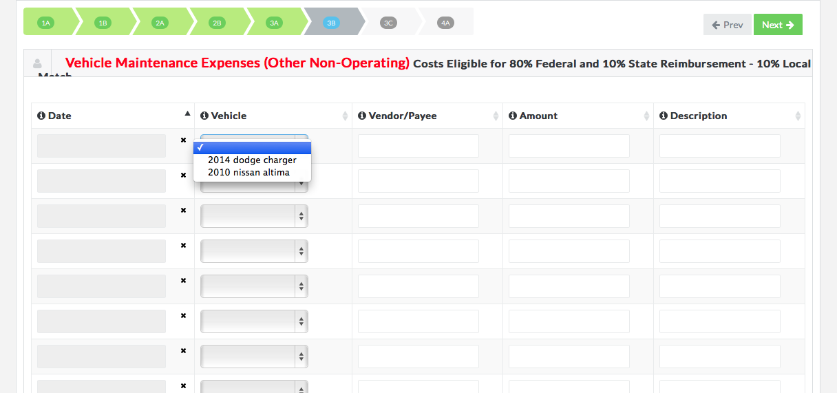
Step 5f: Vehicle Maintenance Expenses (Other Non-Operating) Worksheet
Select the correct vehicle type from the dropdown menu in the Vehicle column.
If your vehicle is not listed in the dropdown menu, please email Kari Ruse, NDOR Transit Liaison Manager, at kari.ruse@nebraska.gov.

Slide 86
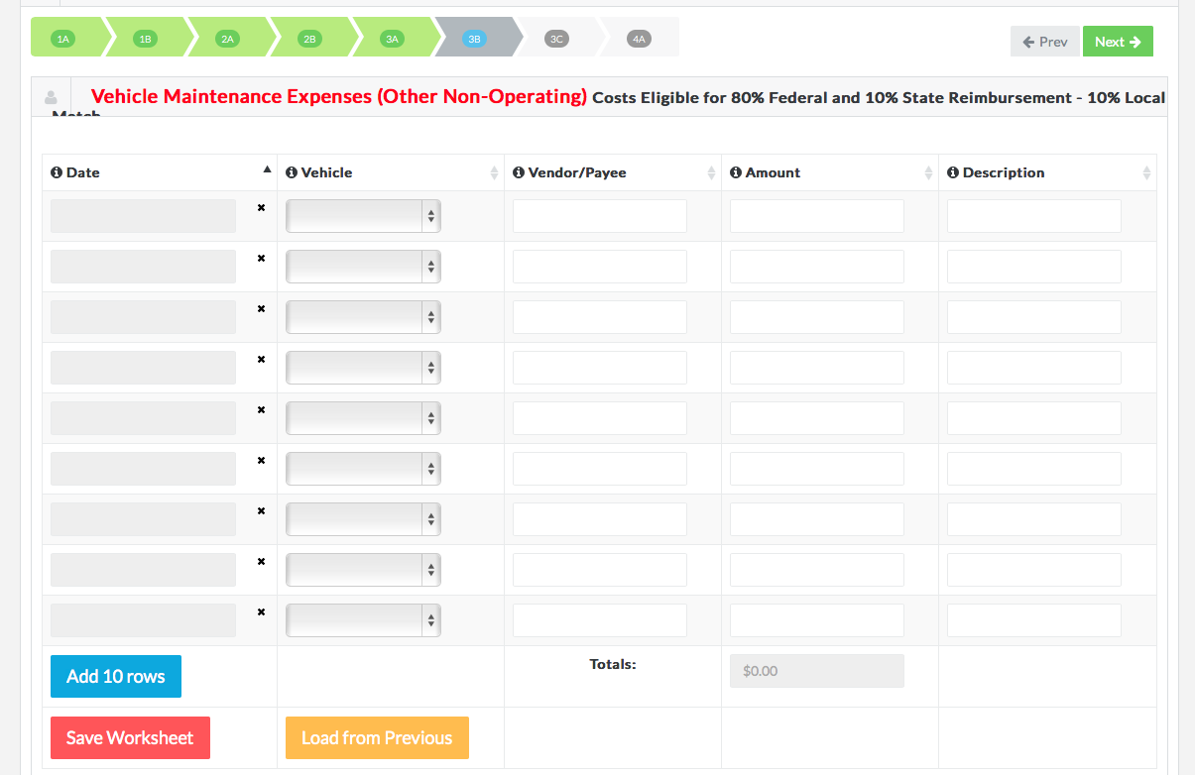
Step 5f: Vehicle Maintenance Expenses (Other Non-Operating) Worksheet
Enter the correct vendor/payee into the Vendor/Payee column.

Slide 87
Step 5f: Vehicle Maintenance Expenses (Other Non-Operating) Worksheet
Enter the correct amount into the Amount column.

Slide 88
Step 5f: Vehicle Maintenance Expenses (Other Non-Operating) Worksheet
Enter a description into the Description column.

Slide 89
Step 5f: Vehicle Maintenance Expenses (Other Non-Operating) Worksheet
Finally, drag-and-drop any supporting documents into the Drop Files to Upload box, or, simply click on the box to select the correct file to upload. Wait until the first file has finished uploading to add additional files. Files have finished uploading when you see the green check mark. To remove a file once you have uploaded it, simply click Remove.

Slide 90
Step 5f: Vehicle Maintenance Expenses (Other Non-Operating) Worksheet
Begin your next entry in the 2nd row. Continue working until you have entered all of your data. If you need more rows, click Add 10 Rows.

Slide 91
Step 5f: Vehicle Maintenance Expenses (Other Non-Operating) Worksheet
Remember to save your work before moving onto the next worksheet!

Slide 92
Step 5f: Vehicle Maintenance Expenses (Other Non-Operating) Worksheet
To begin on the next worksheet, click Next.

Slide 93
Step 5g
Other Non-Operating and Capital Expenses

Slide 94
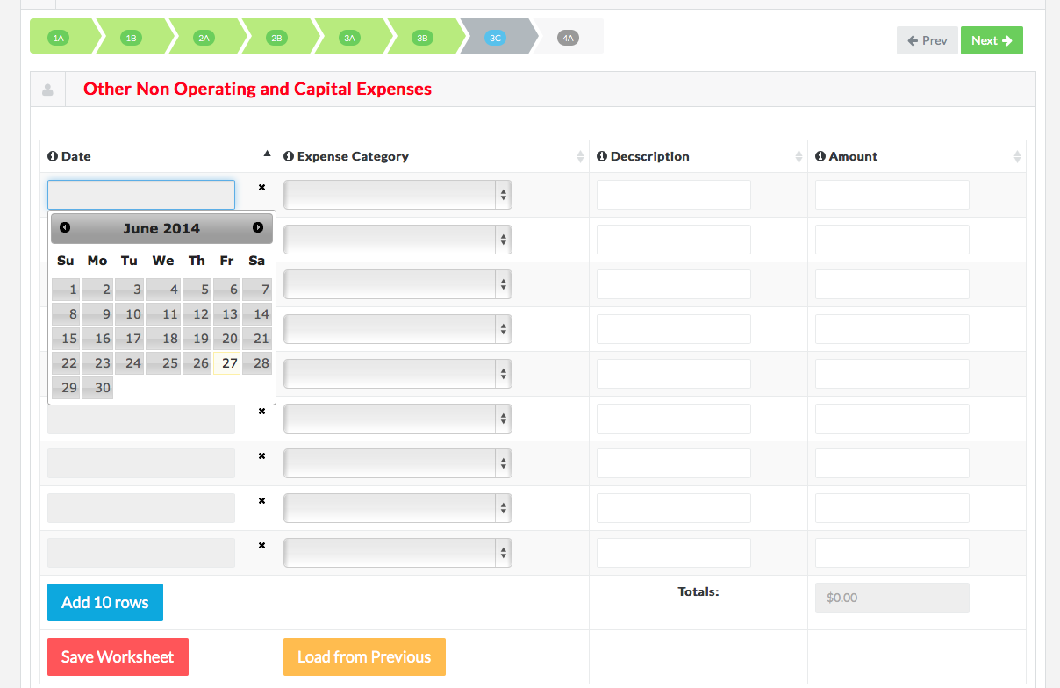
Step 5g: Other Non-Operating and Capital Expenses Worksheet
To begin entering data, click the first empty cell to enter a date in the Date column.

Slide 95
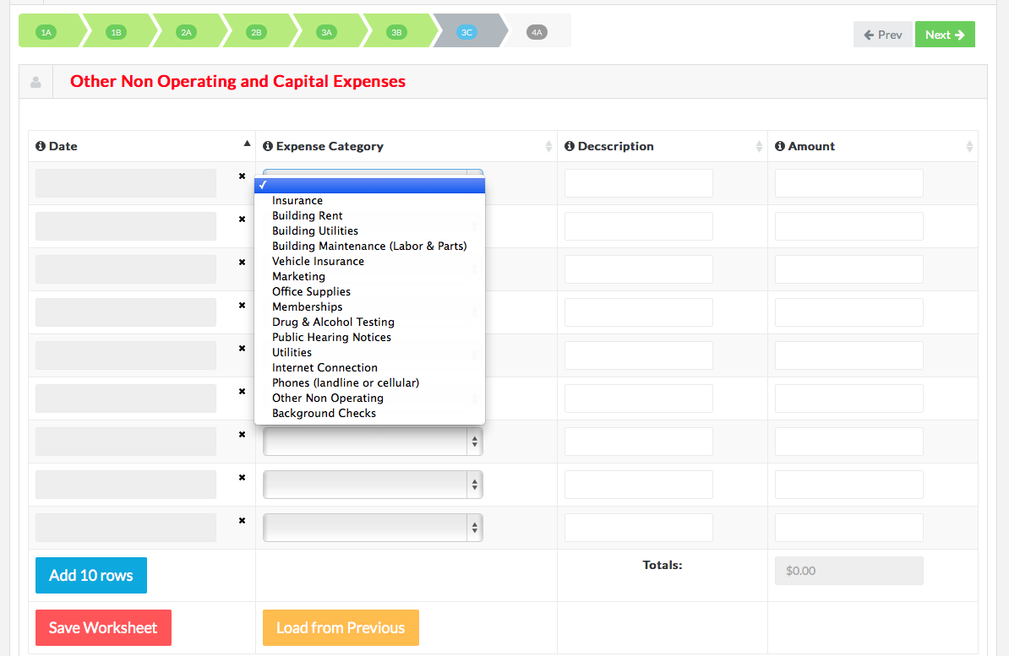
Step 5g: Other Non-Operating and Capital Expenses Worksheet
Select the correct expense category from the dropdown menu in the Expense Category column.

Slide 96
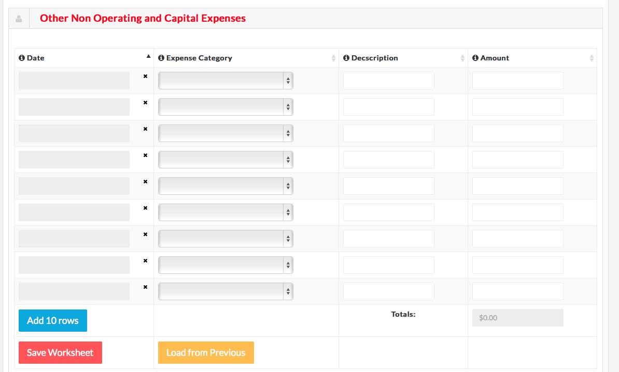
Step 5g: Other Non-Operating and Capital Expenses Worksheet
Next, enter a description in the Description column.

Slide 97
Step 5g: Other Non-Operating and Capital Expenses Worksheet
Enter the correct amount into the Amount column.

Slide 98
Step 5g: Other Non-Operating and Capital Expenses Worksheet
Finally, drag-and-drop any supporting documents into the Drop Files to Upload box, or, simply click on the box to select the correct file to upload. Wait until the first file has finished uploading to add additional files. Files have finished uploading when you see the green check mark. To remove a file once you have uploaded it, simply click Remove.

Slide 99
Step 5g: Other Non-Operating and Capital Expenses Worksheet
Begin your next entry in the 2nd row. Continue working until you have entered all of your data. If you need more rows, click Add 10 Rows.

Slide 100
Step 5g: Other Non-Operating and Capital Expenses Worksheet
Remember to save your work before moving onto the next worksheet!

Slide 101
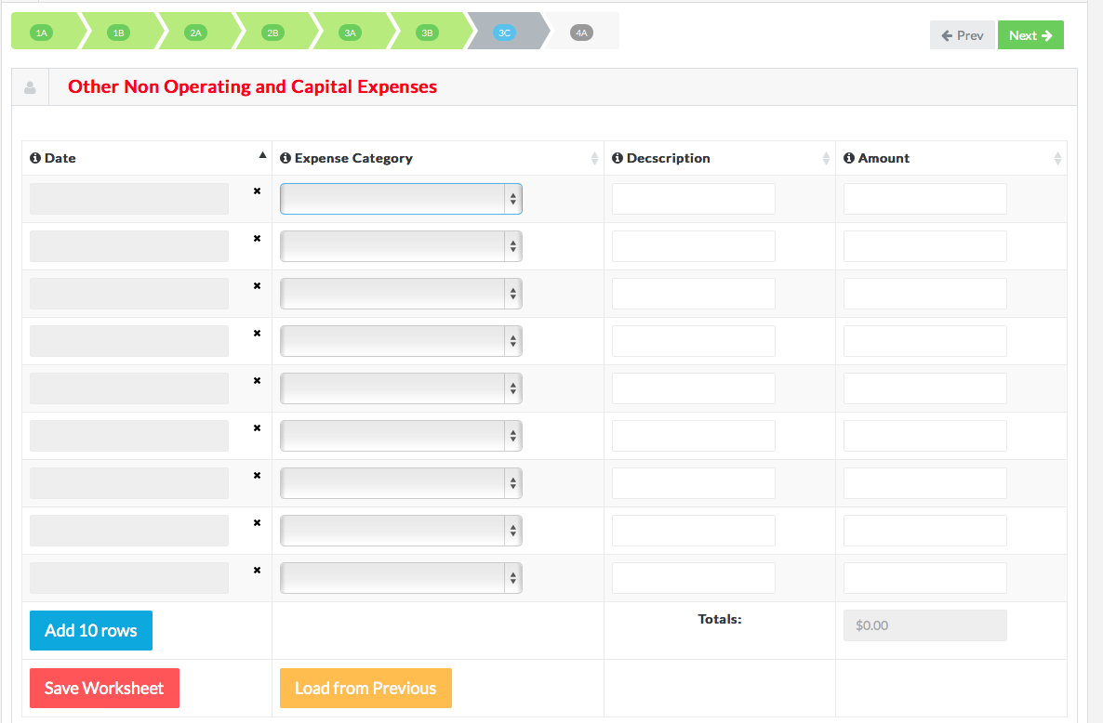
Step 5g: Other Non-Operating and Capital Expenses Worksheet
To begin on the final invoicing worksheet, click Next.

Slide 102
Step 5h
Non-Operating Expenses (Personnel) Worksheet

Slide 103
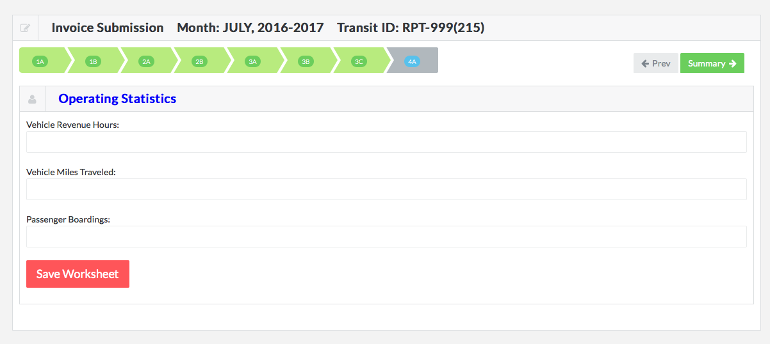
Step 5h: Operating Statistics Worksheet
Enter the correct number of vehicle revenue hours into the first row, Vehicle Revenue Hours.

Slide 104
Step 5h: Operating Statistics Worksheet
Enter the correct number of vehicle miles traveled into the 2nd row, Vehicle Miles Traveled.

Slide 105
Step 5h: Operating Statistics Worksheet
Enter the number of passenger boardings into the 3rd row, Passenger Boardings.

Slide 106
Step 5h: Operating Statistics Worksheet
Don’t forget to save your worksheet before moving on to the next step: summary.

Slide 107
Step 5i:
Draft Invoices Overview

Slide 108
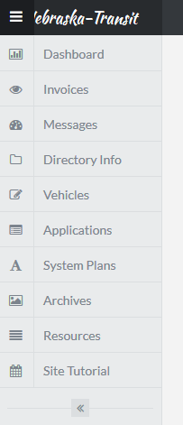
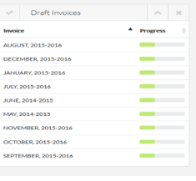
Step 5i: Draft Invoices
If you are working on an invoice and would like to stop and finish later, first make sure you have saved your progress on each worksheet. Next, simply close the program. Your in-progress invoice will be waiting as a Draft Invoice on the dashboard page.
You can return to your dashboard page at any time by selecting “Dashboard” from the sidebar menu (seen at right):
To continue working on a draft invoice, Simply select the invoice from the Draft Invoices window. The invoice will open, allowing you to pick up where you left off. (Drafts pictured at right are examples only.)
Now you are ready to review and submit your invoice by following the directions in Step 6.

Slide 109
Step 6

Slide 110
Step 6: Viewing Summaries and Submitting Invoices
When you have completed the final worksheet, Operating Statistics, you will be ready to review and submit your invoice. First, click Summary.

Slide 111
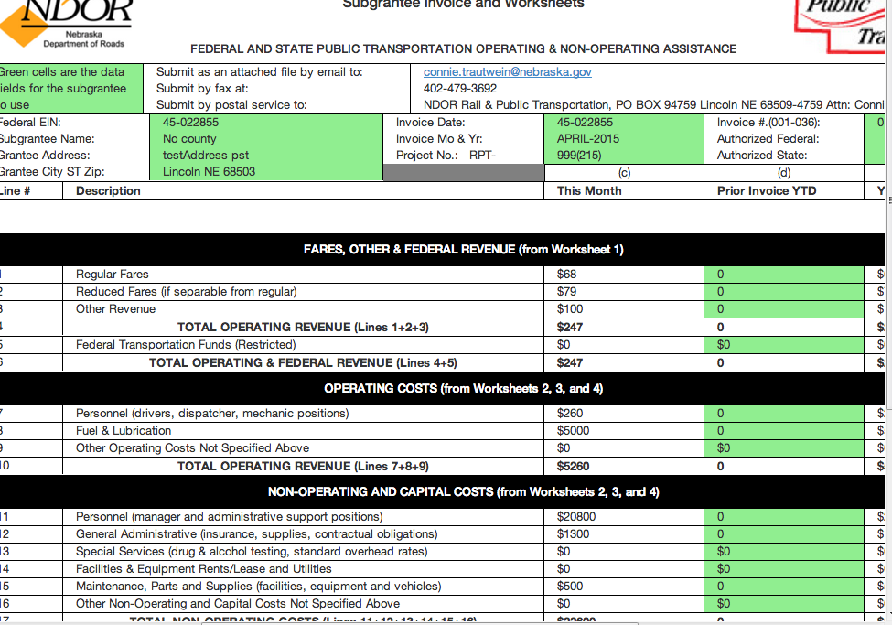
Step 6: Viewing Summaries and Submitting Invoices
You will be taken to the Summary page, which will be auto-populated with your data. The Summary Page looks like this:

Slide 112
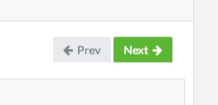
Step 6: Viewing Summaries and Submitting Invoices
From the Summary page, you can review all of the information you have entered for this invoice. If you find incorrect information, you can navigate back to the corresponding worksheet using the Prev and Next arrows.

Slide 113
Step 6: Viewing Summaries and Submitting Invoices
Reenter the correct information in the corresponding cell and click Save Worksheet.

Slide 114
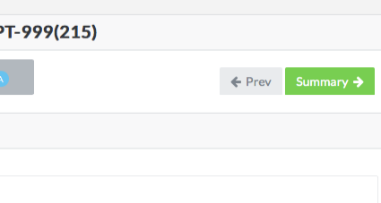
Step 6: Viewing Summaries and Submitting Invoices
After making corrections, you can navigate back to the final worksheet using the Next arrow, then click Summary to get back to the Summary Page.

Slide 115
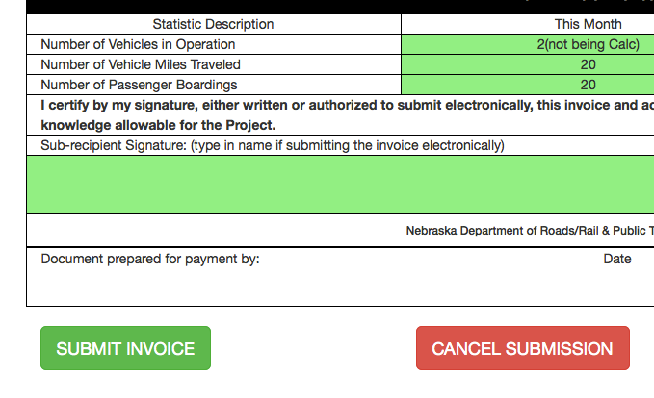
Step 6: Viewing Summaries and Submitting Invoices
When you are sure all of the information you have entered is correct, click Submit Invoice to submit the invoice.
Congratulations! You have just submitted your first invoice using the new system!
NOTE: You cannot submit a new invoice until the previous invoice has been submitted and accepted.

Slide 116
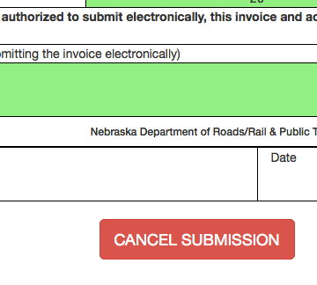
Step 6: Viewing Summaries and Submitting Invoices
You can also cancel an invoice by clicking Cancel Submission. Clicking Cancel Submission will NOT lose your work, but will allow you to return to the worksheets to make changes. Navigate through the worksheets using the “Prev” and “Next” to make changes on a specific worksheet.

Slide 117
Viewing Previous Invoices
To see your old invoices, simply select the invoice you wish to view from the Previous Invoices window on the Dashboard Page.

Slide 118
Viewing Previous Invoices
You cannot work on previously submitted invoices, but you can upload supporting documents to previous invoices. Simply select the previous invoice to open it. Then, navigate to the correct worksheet using the Prev and Next arrows. Then, drag and drop files into the Drop Files to Upload box, or click on the box to browse for the correct file to upload.

Slide 119
Congratulations!
You are now ready to use the new invoicing system! For any questions, please email our support team at: support@nebraskatransit.com.
Congratulations!

Slide 120
Live Session – Q&A
http://nebraskatransit.com/invoice

Slide 121
Kick the Tires After-Party:
If you run into any issues, questions, or “have an idea” let us know!
24 Hours POC – If you have an issue that is preventing you from completing your invoice, you should hear from us every 24 hours until it is fixed!
We anticipate there will be changes, updates, improvements!
We anticipate there will be a few bugs in the first 30 days and at most first 2 billing cycles… 1,800 variables… but understand we are fixing them as fast and furious as possible.
SCREEN SHOTS ARE BEST – CONTROL + PRNTSCRN
Note: Everything in the system you type in until July 30 is for testing purposes only and will be DELETED effective July 31. Do not put anything in the database that is intended for actual use in your July 31 invoice submission.

Slide 122
Overall Impressions?

Slide 123
Feedback 2.0:
What did you like about the website?
What do we need to make clearer?
Suggestions for improvements or enhancements?
Are there things we have not thought about or should add/remove/make clearer?
Anything we did not cover you would like to share??

Slide 124
Thank you!!!!

