Slide 1
Statewide Transit Initiative July 8, 2014 – Transit Managers Workshop
Working together to promote and support safe, reliable, affordable, and efficient public transportation in Nebraska.

Slide 2
NU Transit Theme

Slide 3
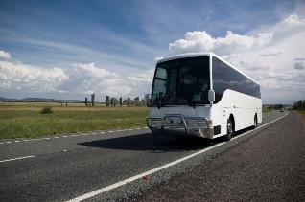
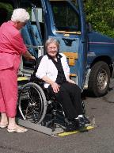
NEBRASKA TRANSPORTATION ACT
13-1204. Department of Roads; coordinating and technical assistance agency; contracts authorized.
The department shall be the principal state agency responsible for coordinating public transportation activities in the state and, when requested, shall provide technical assistance to improve Nebraska’s public transportation system. The department may contract pursuant to the Nebraska Public Transportation Act to assist state agencies, political subdivisions, and public and qualified public purpose organizations to provide public transportation services as specified in the act.

Slide 4
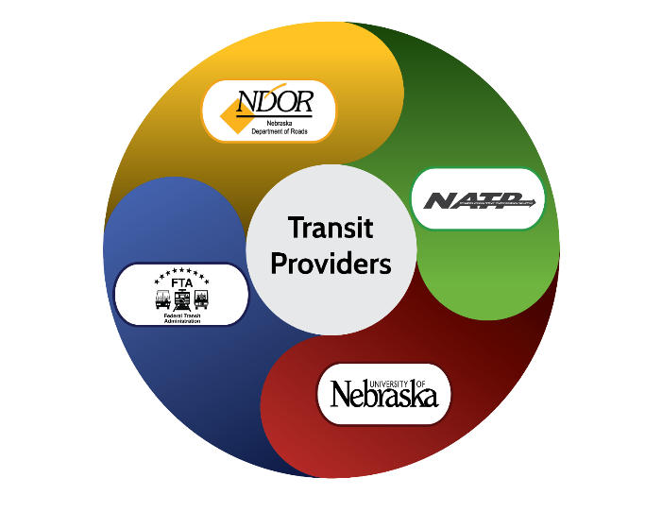
Our Partnership

Slide 5
NDOR – NU Statewide Transit Initiative Team

Slide 6
Semi-Annual NU Update
Website
Listserv Utilization
Spanish Language Training
Title VI Compliance
Drug & Alcohol Compliance
Driver Training
Intercity Bus Study
Mobility Management
Marketing
Intranet Website Updates

Slide 7
nebraskatransit.com

Slide 8
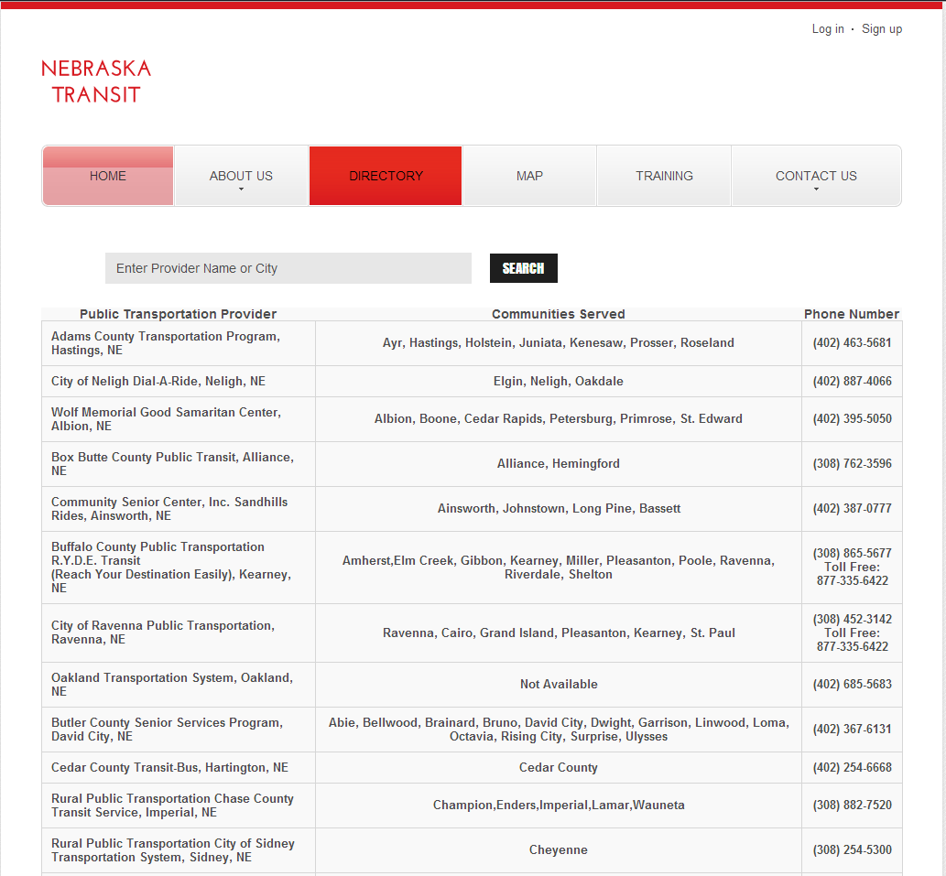
nebraskatransit.com

Slide 9
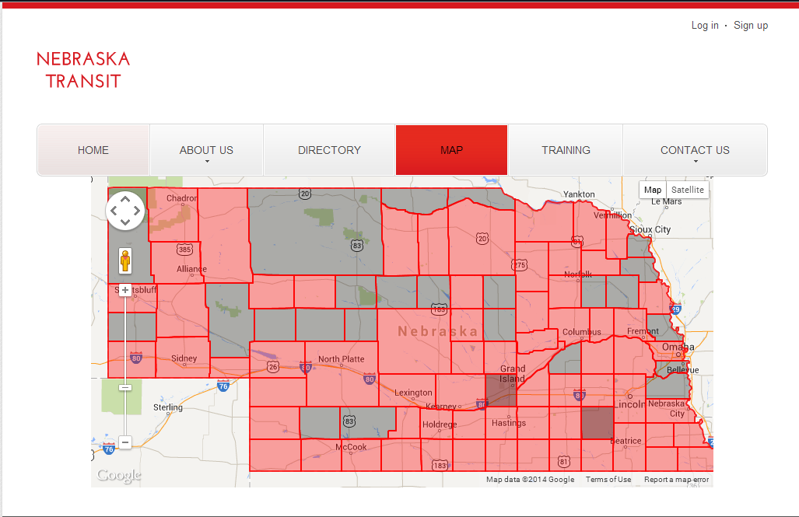
nebraskatransit.com

Slide 10
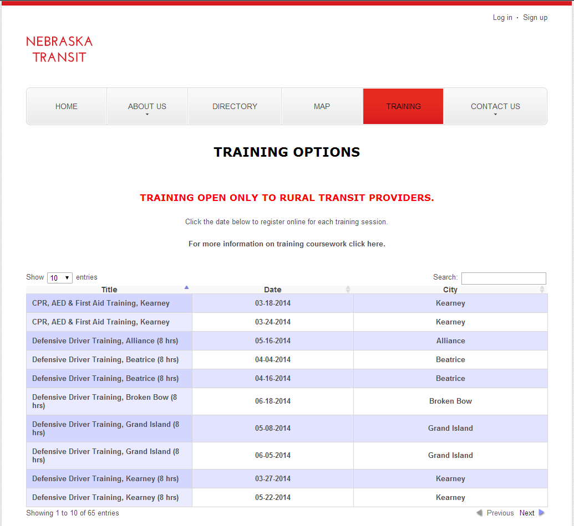

Slide 11
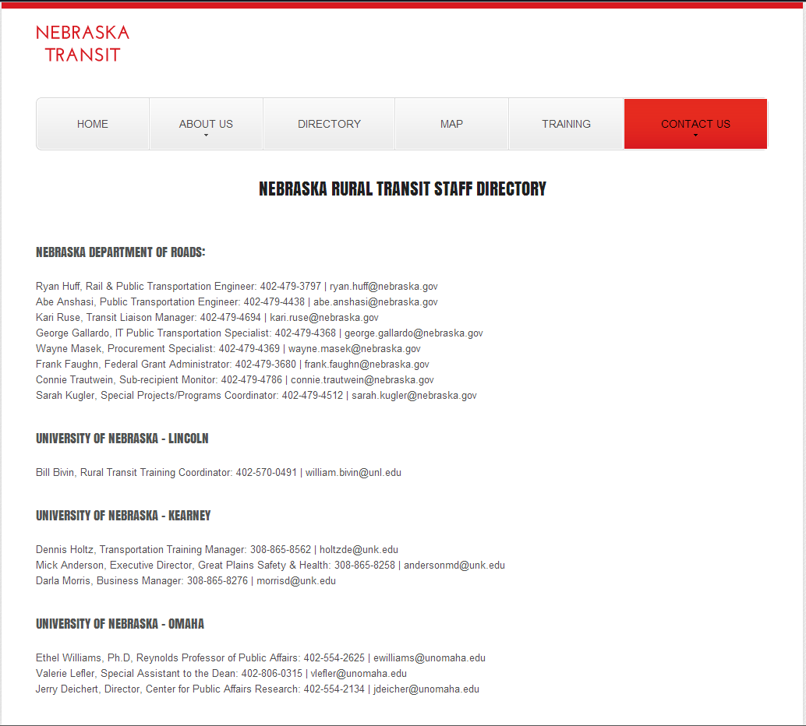
nebraskatransit.com

Slide 12
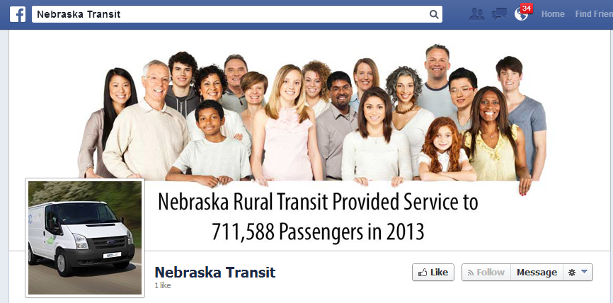
Notes:
Like us on facebook!

Slide 13
Website Traffic
Visits: 4,784
Page Views: 11,736

Slide 14
LISTSERV—Connecting the Transit Community
Valuable resource for exchanging information with your peers
Created by UNL at NDOR Request: December 10, 2013
83 Subscribers
Approximately 200 messages
Topics: Intelliride, Marketing, Weekend Hours,
To subscribe/unsubscribe/change your email address, email william.bivin@unl.edu

Slide 15
Spanish Language Training
UNL hired a fluent Spanish speaker and translation specialist to work on the training
Gabriel Bruguier
Using curriculum based upon Indiana & Colorado DOT’s Basic Spanish for Transit Employees as guide to develop the training
Developing an online short-course
Focus Group
Focus Group: Counties from high LEP needs.
Other needs? In-person training? A pocket guide?
Send feedback to willliam.bivin@unl.edu

Slide 16
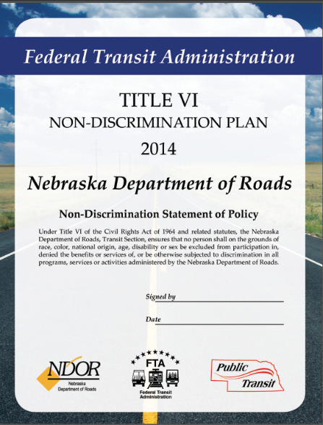
Statewide Title VI Plan
Updated State of Nebraska Title VI Plan
Required to be Updated Every 3 Years
Under FTA Review

Slide 17
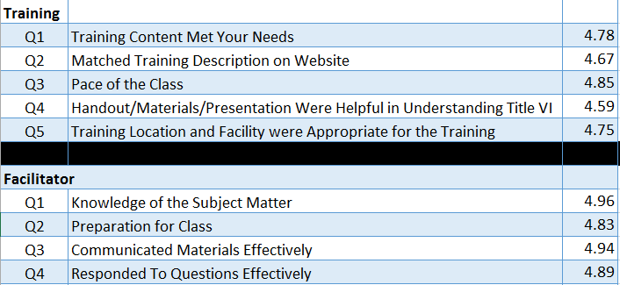
Title VI Sub-recipient Training
98 People Trained
O’Neil
Lincoln
Omaha
Kearney
Scottsbluff
North Platte
Manuals – 80%-90% Complete by EOT
Finalizing all Plans by 5.30.2015

Slide 18
Future Training Fall 2014-Spring 2015
Title VI Full-day Hands on Developing Plan (Additional Sessions)
Title VI Refresher ½ Day Sessions
Title VI Online 90 Min Employee Training
Reoccurring Online “Evergreen”
Registration for New Sessions Open in August

Slide 19
Drug & Alcohol Compliance
Precision Compliance, Boulder CO
Beverly Krieger
Linda DeHerrera
62 People Trained
Locations: Lincoln, Kearney, North Platte, & Scottsbluff

Slide 20
Drug & Alcohol Compliance

Slide 21
Driver Training
Requirements Implemented – January 2014
Core elements:
Defensive Driving
Passenger Service & Safety Training
Elective Courses:
CPR-First Aid
Child Safety Restraints
Initial Goal: Drivers Trained by August
70-85% Anticipated to be Trained
New Goal: All Drivers Training by December 2014

Slide 22
Driver Training in Review

Slide 23
PASS Attendees

Slide 24
DD Attendees

Slide 25
CPR, AED & First Aid Attendees

Slide 26
Safe Kids Childcare Transportation Attendees

Slide 27
Table Summary
Course | Attended Course | Not Attended Course (to date) | Other(s) | Total
PASS | 302 | 83 | 4 | 389
DD | 274 | 112 | 3 | 389
First Aid | 38 | - | - | 38
Safe Kids | 19 | - | - | 19
* 76 (30 PASS, 46 DD) attendees who have not taken the course have also NOT registered

Slide 28
Course Evaluation Responses

Slide 29
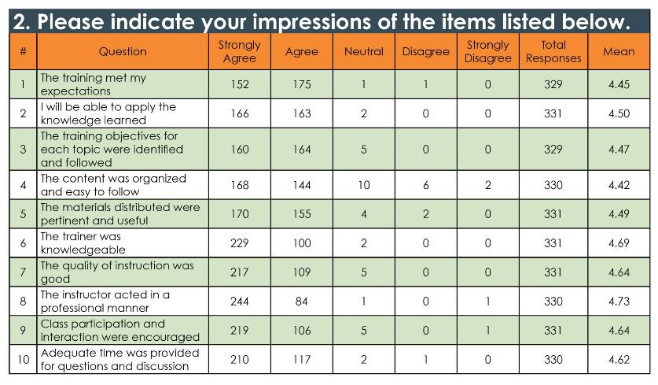
Course Evaluation Responses

Slide 30
Course Evaluation Responses

Slide 31
Future Training
Give us your feedback! What do you need?
Title VI Topics
Driver Topics
Transit Manager Topics
LEP Topics
Drug & Alcohol Compliance Topics

Slide 32
Intercity Transit Study

Slide 33
Background
Conducted by UNO Center for Public Affairs Research
NDOR Request
Required by FTA – Utilize less than 15% Section 5311 Funds Must Document Need
Finalizing Report
FTA Review – Decide on Action Plan & Next Steps

Slide 34
Source: U.S. Census Bureau, 2010-2012 American Community Survey Public Use Microdata Sample, Prepared by UNO Center for Public Affairs Research, June 2014.

Slide 35
Source: U.S. Census Bureau, 2010-2012 American Community Survey Public Use Microdata Sample, Prepared by UNO Center for Public Affairs Research, June 2014.

Slide 36
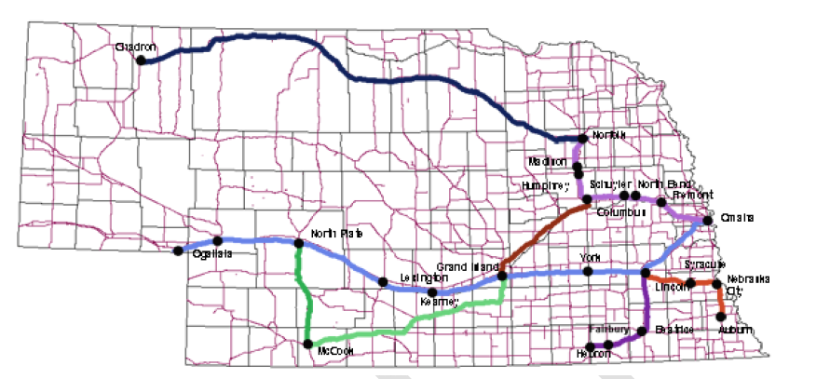
Map of Service Provided by Intercity Bus Systems
There are 12 first class cities that do not have scheduled stops and which are not on the routes of those providers that make additional stops.
There are four metropolitan counties not served: Dakota, Dixon, Washington, and Saunders. There are nine micropolitan counties not served: Scotts Bluff, Banner, McPherson, Logan, Gosper, Clay, Howard, Stanton, and Pierce.

Slide 37
Route Needs Assessment Research
Commuting Patterns
Customer Analysis
Employer & Educational Institution Survey / Focus Group
Area Agency on Aging Focus Groups
Phone Survey
Website Survey

Slide 38
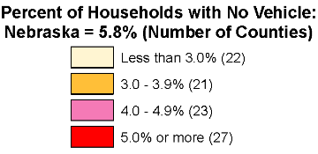

Slide 39
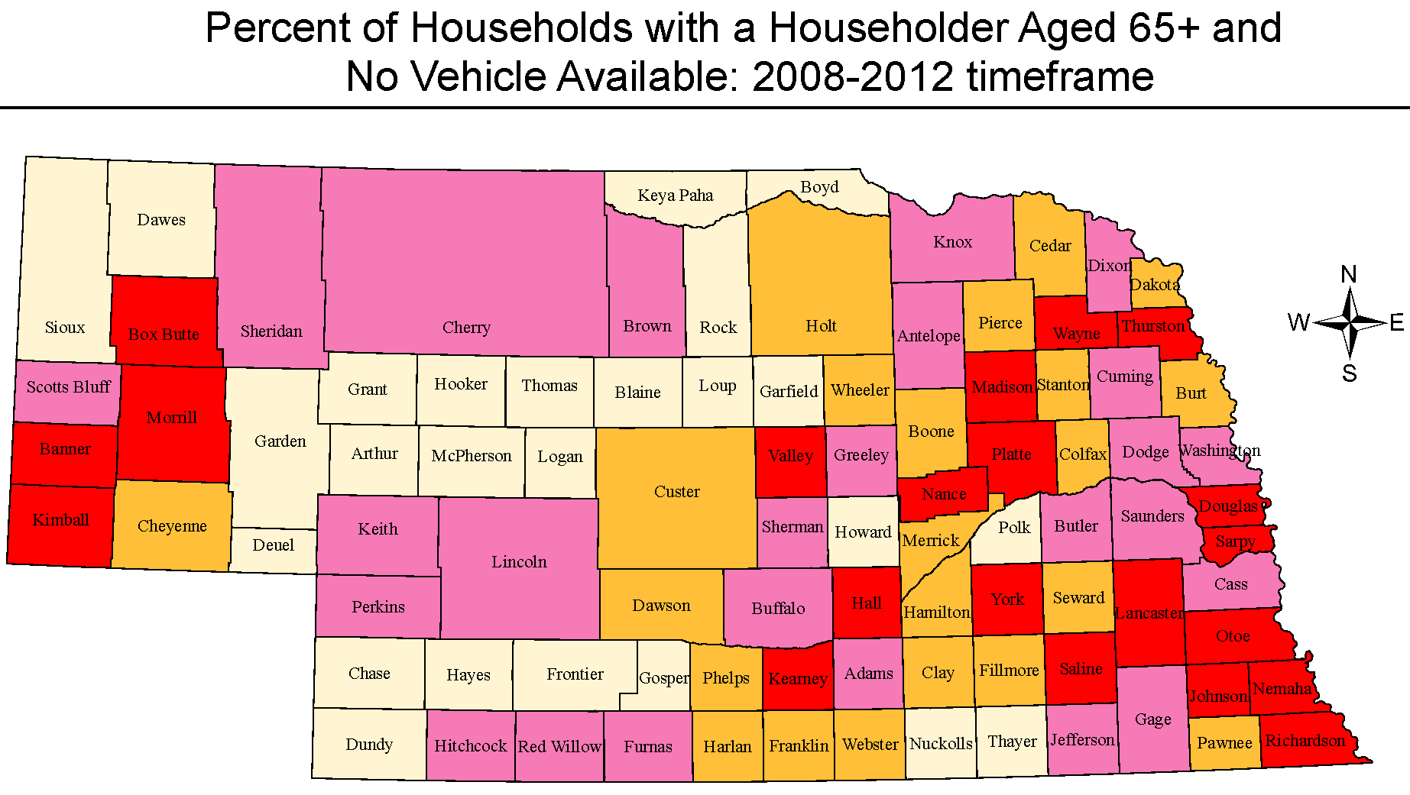
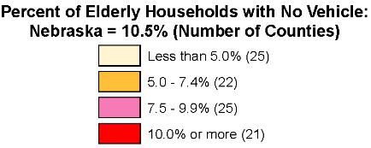

Slide 40
Mobility Management
Consists of short-range planning and management activities and projects for improving coordination among public transportation and other transportation service providers carried out by a recipient or sub recipient through an agreement entered into with a person, including a government entity, under 49 U.S. C. Chapter 53.

Slide 41
CURRENT ISSUES
Sixty-one independent rural transit systems
Limited coordination among recipients and sub-recipients of State and Federal funding (Sections 5311, 5310, 5307)
Rural systems
Non profit agencies serving the elderly and disabled
Large and small urbanized areas
Availability of public transportation is vital to keep an aging population in their homes

Slide 42
Why Coordinate and Regionalize Public Transportation?
Coordinate services to increase efficiency
Provide statewide public transportation service
Improve planning capabilities
Facilitate consistency in service, fares, salaries, etc.
Pool local match resources
Collaborate to achieve interconnectivity across regions
Maximize opportunities for asset management

Slide 43
Role of the University
Statewide Transit Initiative
Mobility Management Task
Research
Public engagement
Policy language
Facilitate legislative action
Marketing

Slide 44
Future NDOR & NU Activities
Improved Statewide Map & Updated Detailed Information
Statewide & Targeted Marketing
Website Transit Manager “Intranet” Portal

Slide 45
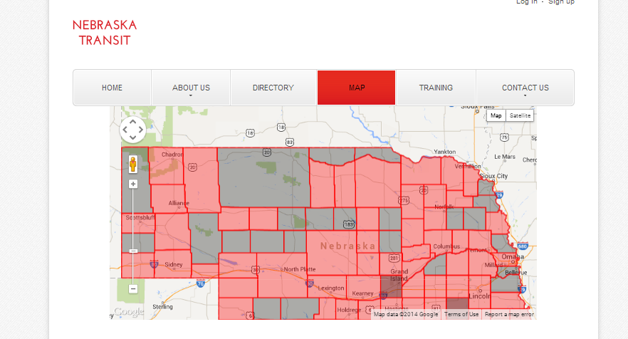
New Map Detailed Information

Slide 46
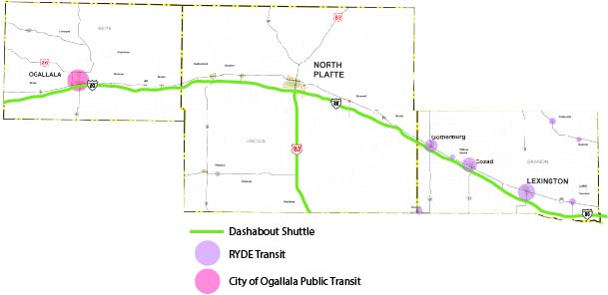
Statewide & Regional Route Maps

Slide 47
New Features: - Ability to Drill Down - Ability to See Multiple Providers Per County - Downloadable Printable PDF with Contact Information, Hours, Etc.

Slide 48
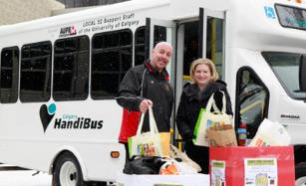
Statewide Marketing Support
Brochures
Can detail hours, routes, availability, and special services.

Slide 49
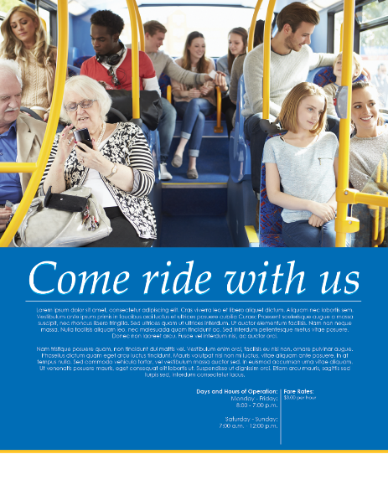
Posters
Allows for quick details and eye-catching information and graphics
Can be used to offer basic information like hours of operation and fares

Slide 50
Flyers
Best for quick advertising of information and specific events.

Slide 51
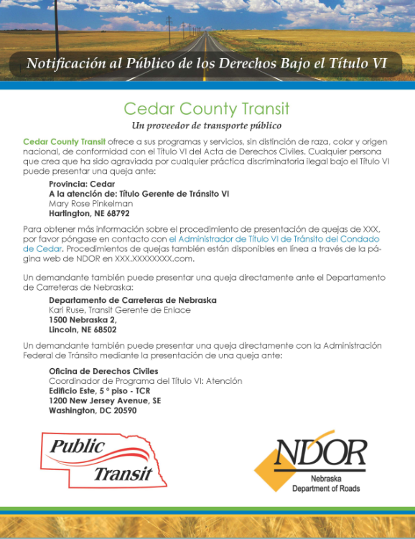
LEP Marketing & Title VI Support
Provide all materials requested at no additional cost in:
Spanish
Arabic
French
Chinese
Vietnamese
Other languages upon request

Slide 52
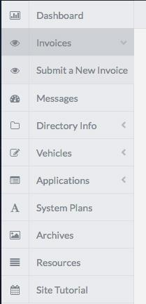
Intranet Future Updates 2014- 2015

Slide 53
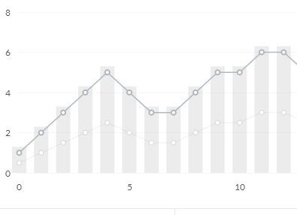
Administrative Reports
Vehicle Maintenance
Vehicle Miles
Passengers
Driver Training Reminders
Revenue & Expense Summary
Others??

Slide 54
QUESTIONS?

