Slide 1
Optimizing Your Business Facebook Page
Connie Hancock and Jenny Nixon
Nebraska Extension - Community Vitality

Slide 2
What’s Your “Red and White”?
Brand Awareness
What do you provide?
What do you want your customers to remember?
What images reflect your business?

Slide 3
Digital Marketing Strategy
Target Audience - 1.4 billion active users
Need an engaging and accessible page
Need to have FB page set up properly and optimized
Audience has short attention span

Slide 4
First Impressions
Profile Photo and Cover Photo

Slide 5
Profile Pic
Dimensions
170 x 170 pixels for computers
128 x 128 pixels on smartphones
36 x 36 pixels on most feature phones
Will be cropped to fit a square
Need description –
Normally logo - hardly ever changes

Slide 6
Cover Pic
Can use image or stock photo
Dimensions
820 pixels wide by 312 pixelstall on computers
640 pixels wide by 360 pixels tall on smartphones
Doesn’t display on feature phones
Must be at least 399 pixels wide and 150 pixels tall
sRGB JPG photo that’s 851 pixels wide, 315 pixels tall and less than 100 KB
Images with a logo or text may be best as a PNG file
Description

Slide 7
Every time you share images
You create an ‘experience’ for your fans
You create brand awareness of your products/services/people
They reflect YOU
They reflect YOUR FAMILY
They reflect a ‘visual’ thing that is either good or bad

Slide 8
Vanity URL
www.facebook.com/YourBusinessName

Slide 9
Go to www.facebook.com/username
Select “Select a Username” for your page
This brings up a drop down menu, select the page you want to create the username for.
If your page has the needed 25 fans it will bring up a box .
Enter your desired username and click on “check availability”
If it’s available, you will be shown some final terms – if you are happy with your choice click “confirm” or select “cancel” to try another one.
Source - https://www.facebook.com/notes/equine-calculator/how-to-claim-your-vanity-url-for-your-facebook-page/474147772600069/

Slide 10
Properly Optimizing
About Page
DO NOT LEAVE OUT YOUR DESCRIPTIONS
About - Short Description –
155 characters
Describe exactly who you are and what you provide
Story – Long Description
More in-depth
Can write a “Mission” – allows you to show your values and what your business stands for
Page is not optimized without contact information, mission and descriptions

Slide 11
Settings
Verified - blue or white check mark
Post
View visitor post before posting
Profanity
Other things do not apply
Messaging
Page Info
Page roles
Instagram/Flip – A – Gram/FB Live

Slide 12
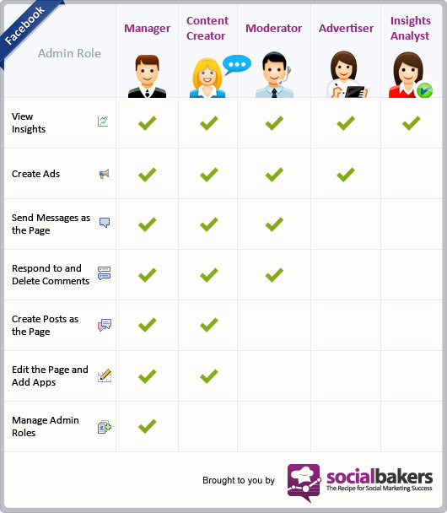
Facebook
Administrator
Page
Roles

Slide 13
Posting
Schedule it - NEVER PUBLISH NOW
Can edit text - cannot change photo
View in desktop/mobile format
Pin Important Posts to the Top

Slide 14
Fill In the Blank Posts
Tell us one word: My cat gets most excited for _________
Help us caption this photo _________________
What lessons do you share with other entrepreneurs?
Source - http://mashable.com/2012/07/05/facebook-build-engagement/#VmcQhbyDg8q7

Slide 15
More Engaging Thoughts
Tips are ideas that fans can consume and implement easily
Quotes – easy and popular way to get likes and shares
Source - http://mashable.com/2012/07/05/facebook-build-engagement/#VmcQhbyDg8q7

Slide 16
PHOTOS
Catch People’s Attention
Large Colorful Images
Enhances your Brand
Include a shortened Link
ALL Photos need a Caption

Slide 17
PHOTOS
PICTURES - need to be horizontal!
Over time, share images to create brand awareness
Images reflect YOU, your family, a visual thing that is either good or bad
FB looks at image left to right
Vertical pics do not get the reach of horizontal pics
Can use up to three images in a post
Use collages cautiously

Slide 18
Hashtags
Helps build brand - and builds brand quickly
Gets an experience of your business
Red and White
Helps tell your story
Easy to track your posts
#yourbusinessnamegifts
#yourbusinessnameideas
#yourbusinessname

Slide 19
FB records every…….
FB records every like, share, comment to maximize organic reach
contests
images
adding text to description
4% are going back to your FB page
96% see content in newsfeed - need strong connection between like and comment
75% loaded by mobile devices

Slide 20
Facebook Insights
Get data on:
Likes
Reach
Visits
Posts
People

Slide 21
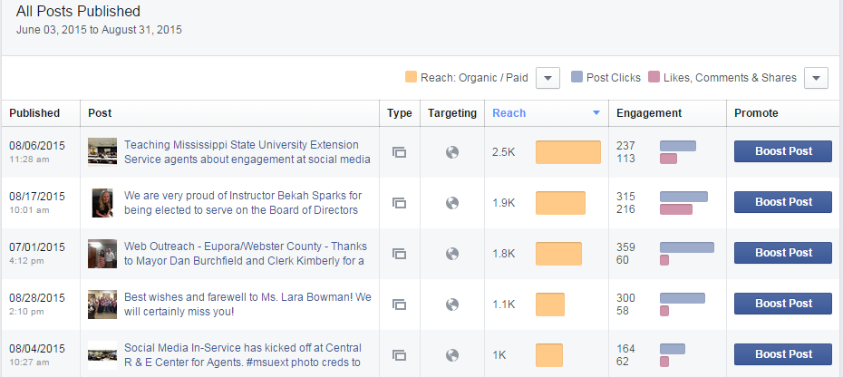
Facebook Insights

Slide 22
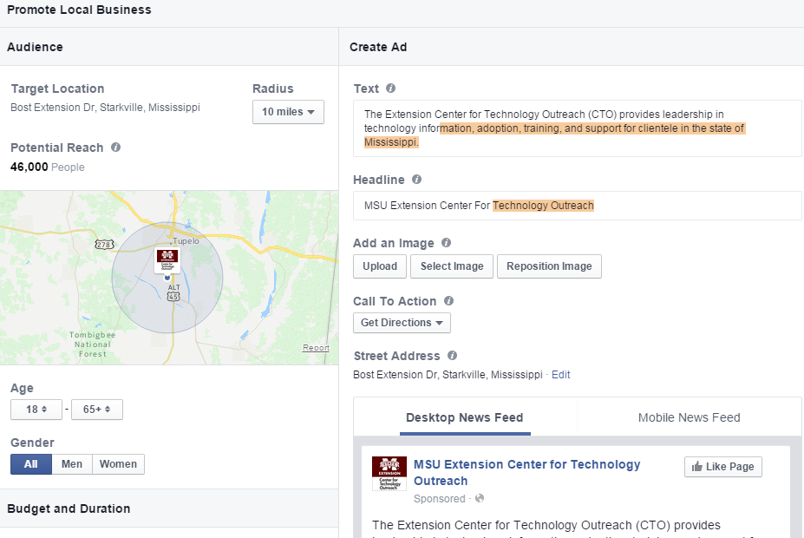
Facebook Ads
Promote page
Promote specific posts

Slide 23
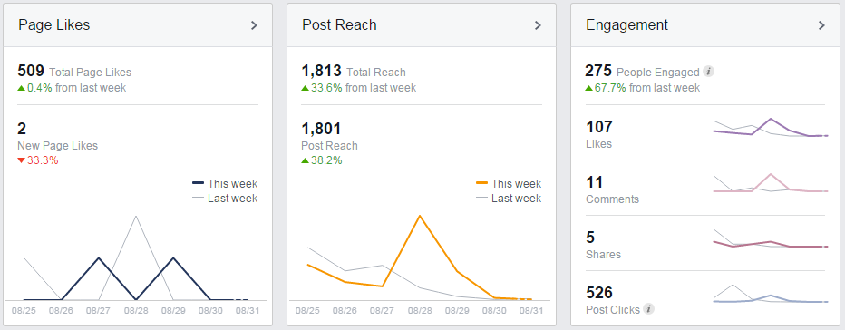
Facebook Engagement Factor (FEF)
FEF = divide no. people engaged by total page likes, multiply times 100
FEF = 275/509 = 54.0
Above 10 shows good engagement

Slide 24
Facebook Marketing Resources
MSU Bricks to Clicks – http://msbrickstoclicks.com/
MSU eBiz Social Media Marketing: Facebook http://srdc.msstate.edu/ecommerce/ebiz/files/msu_ebiz_facebook.pdf
“Maximizing the Economic Value from Facebook Marketing in the Agrifood System: Boosting Consumer Engagement Through Contests”, Journal of Extension http://www.msbrickstoclicks.com/files/Forthcoming_Maximizing%20the%20Economic%20Value%20from%20Facebook%20Marketing%20in%20the%20AgriFood%20System.pdf
“The Economic Value of Social Media Advertising on Mississippi Agribusiness: The Case of MG Farms, Inc.”, Mississippi State University Extension.
http://www.msbrickstoclicks.com/files/2912_Econ%20Value%20MG%20Farms.pdf

Slide 25
Free Stock Websites with Images
https://stocksnap.io/
https://unsplash.com/
http://www.splitshire.com/
http://snapwiresnaps.tumblr.com/
https://www.canva.com/
http://www.dreamstime.com/

Slide 26
Optimizing Your Business Facebook Page
Connie Hancock - chancock1@unl.edu
Jenny Nixon – jnixon@unl.edu

